Slide 1
eTMF Good Vault Practices
eTMF
Good Vault Practices
Version: March 4, 2024

Slide 2
Summary of changes
Version date | Summary of Changes
1/6/2023 | Initial
3/4/2024 | Slide 36: Addition of ability to designate a study site as the reference site for that specific study or study country Slide 121: Slide replaced to list the relevant inbound email addresses available

Slide 3
Table of Contents
Managing reference data
Create a study
Plan Initial trial requirements
Managing trial in vault
Document inbox
File a document
Working with documents
Maintaining inspection ready
Closing out and archiving trial

Slide 4
Managing Reference Data
Good Vault Practices

Slide 5
Content Outline
Introduction to Reference Data
1
How to Create Reference Data
Create an Organization
Create a Location
Create a Person
Create Contact Information
Create a Product
2
How to Update Reference Data
Update a Person
Update Contact Information
3
How to Inactivate Reference Data
Inactivate a Person
Inactivate an Organization
4
Notes:
We organized the Best Practices with clear content outline and jump links. This is to enable later use by clients to open the deck and hop to the section they need

Slide 6
Types of Reference Data
Person
Contact Information
Organization
Location
Product
Name and title of people who may participate in a study
Auto-created from User creation
Allows linking of additional data like Contact Information and Related Documents
Later used as:
Study Person
Study Site Principal Investigator
Contact details for a person that may/may not be organization-specific
Later used as:
Primary Contact Information for Study Person
Organization specific Contact details
Institution, IRB, Sponsor or Vendor that may participate in a study
Allows linking of additional data like Location
Later used as:
Study, Study Country, or Study Site Organization
Physical address(es) of an organization’s facilities
Allows linking of additional data like Available Staff, Equipment and Facilities
Later used as:
Site Organization’s Primary Location
Additional Study Site Location
Represents devices and comparators that may be utilized in a study
Later used as:
Study Product

Slide 7
Benefits of Managing Reference Data in Vault
Provide a single source of truth for people, organizations, and products that may be used across trials
Improve reporting and reuse of this data within Vault
Maintain current contact lists for organizations, locations, and people
Tag documents with related people and organizations

Slide 8
Best Practices
Person, Contact Information, Product, Organization & Location
Method | Best Practice Guidance
 | Person | Contact Information | Organization | Location | Product
Creating Reference Data | Confirm the Person does not already exist; there is no system duplicate detection based on name When a User is added to Vault, a Person will automatically be created If the Person will also be a User in the future, consider waiting to add, or consider functionality to Promote to User from the Person record Only an “Investigator” person type can be linked to a Study Site as PI | Admins should update the “Personal” type Contact Information as needed before creating a new Contact Information record Additional contact records can be created to denote organization specific contact info | Confirm the Organization does not already exist; system duplicate detection will not account for capitalization or additional characters Parent Organization field should be used to link two Organizations (E.g.,: SMOs, Networks, mergers) Each Institution that could be a Study Site should be represented by a unique Organization record and have its unique USN An Organization should never be linked to more than one Study Site in the same Study | Confirm the Location of an Organization does not already exist; there is no system duplicate detection based on Location Name Create a new location if information is updated on an existing Location. For example, if an office relocates, create a new location to preserve previous data | Products should be added individually in Vault. More than one Product can be linked to a study if needed.
Updating Reference Data | Use 'Change Type' with caution as it may overwrite existing field or section content due to differences by Person Type | Update the email and phone number of the ‘Personal’ Contact Information record from Person’s page under Details | Use 'Change Type' with caution as it may overwrite existing field content due to differences by Organization Type | If updates to a Location are required, consider inactivating the existing record and adding a new location in order to maintain historical data
Inactivating Reference Data | Consider inactivating a Person only in cases of death or debarment | Utilize Expiration Date on Contact Information to indicate if it should no longer be referenced | Only inactivate an organization if it should no longer be used in New Studies | Only inactivate a location if it should no longer be used in New Studies or when information is outdated | Only inactivate Product records when the Product should no longer be used in new Studies
Deleting Reference Data | Best practice in almost all scenarios is to inactivate rather than delete Deletion should only be considered in the event of duplicates or bad data

Slide 9
Institutions
Organization Types
Institution is a type of Organization used to denote a place where patients are seen (E.g: a Site!).
Each unique site should be represented by a unique Organization and have its own USN number.
Example: If this is a site part of a site network, each primary place seeing patients is its own organization
Example: For a private research site, their primary place seeing patients is the organization
Example: For a large teaching hospital, a “Site” might be the department, therefore each department is its own organization.
Example: Mayo Clinic could be the parent organization of multiple sites w/ USNs: Mayo Clinic | Dermatology, Mayo Clinic | Ophthalmology.

Slide 10
Institutions
Organization Types
Use the Parent Organization field to link multiple organizations together.
Example in Vault: Research University
Example in Vault: Large Network
Parent Organization field is used to relate each department back to the main organization of University of Louisville.
Since each region will have their own unique patients, each region is listed as a unique organization.
Parent Organization field is used to relate each region’s Mayo Clinic back to the main organization.
Since each department could have their own pool of patients, and therefore be its own site, each department is listed as a unique organization.

Slide 11
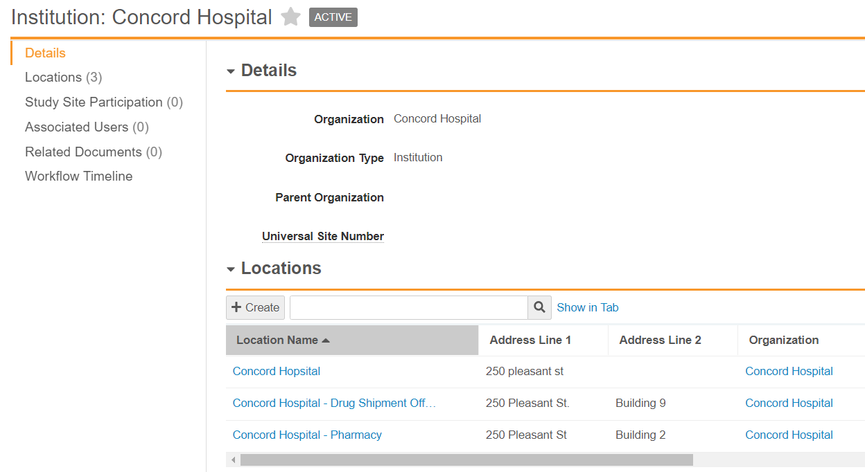
Locations
Use multiple Locations for the same organization to identify unique addresses for that Organization.
Example: Drug Shipment Office, Pharmacy, Lab, etc
Each location listed may have the same primary address, but differ slightly based on Office Suite, Building Number, etc.

Slide 12
How to Create Reference Data

Slide 13
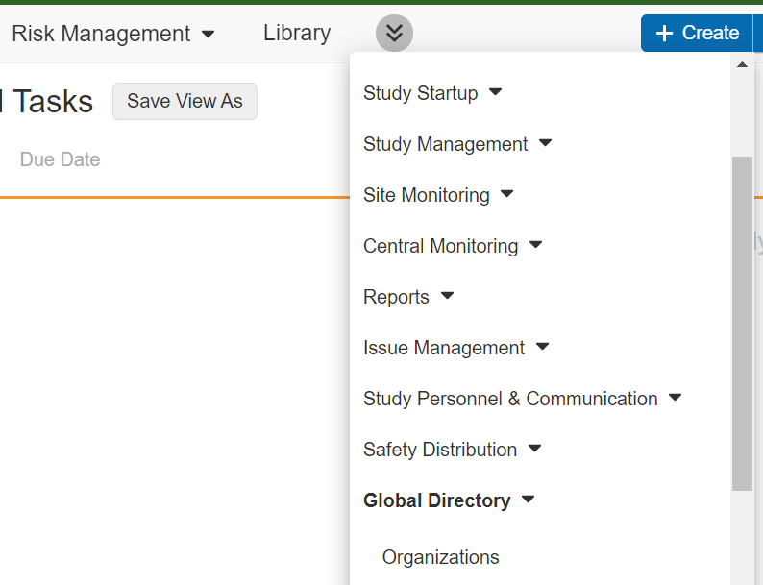
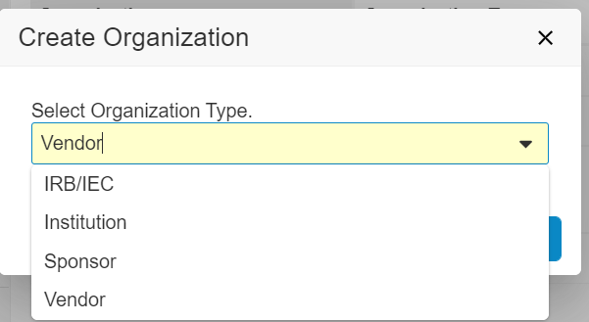
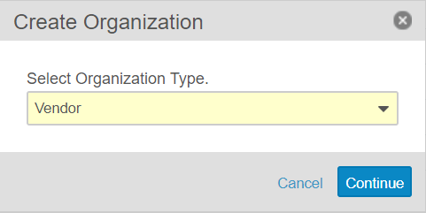
Create an Organization
Navigate to the Global Directory tab, and select Organizations.
Note: the Global Directory tab may be located under the double arrows in the Navigation bar, depending on the user’s page setup.
Verify that the Organization does not exist already in Vault by searching for the organization.
Note: Ensure ‘All Organizations’ is selected when performing a search.
Once confirmed that the organization does not already exist, click +Create.
Note: Clicking the down arrow next to +Create gives options to create items that were recently created as well as an Organization.
In the pop-up window, select the appropriate Organization Type.
Click Continue.
1
3
4
5
2

Slide 14
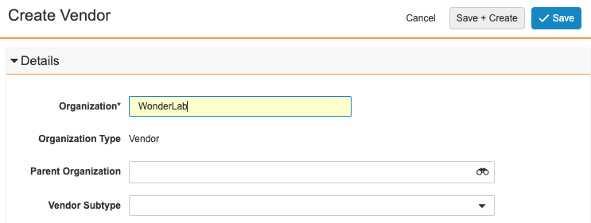
Create an Organization
Populate the Organization field, and any other applicable fields.
Click Save.
Note: to continue creating organizations of the same Organization Type, click Save + Create to open a new creation page.
Note: This organization can now be associated with studies, study countries, and study sites.
Note: there might be different fields available depending on the Organization Type selected. For example, for the Vendor Organization Type, there is a Vendor Subtype picklist field.
7
6

Slide 15
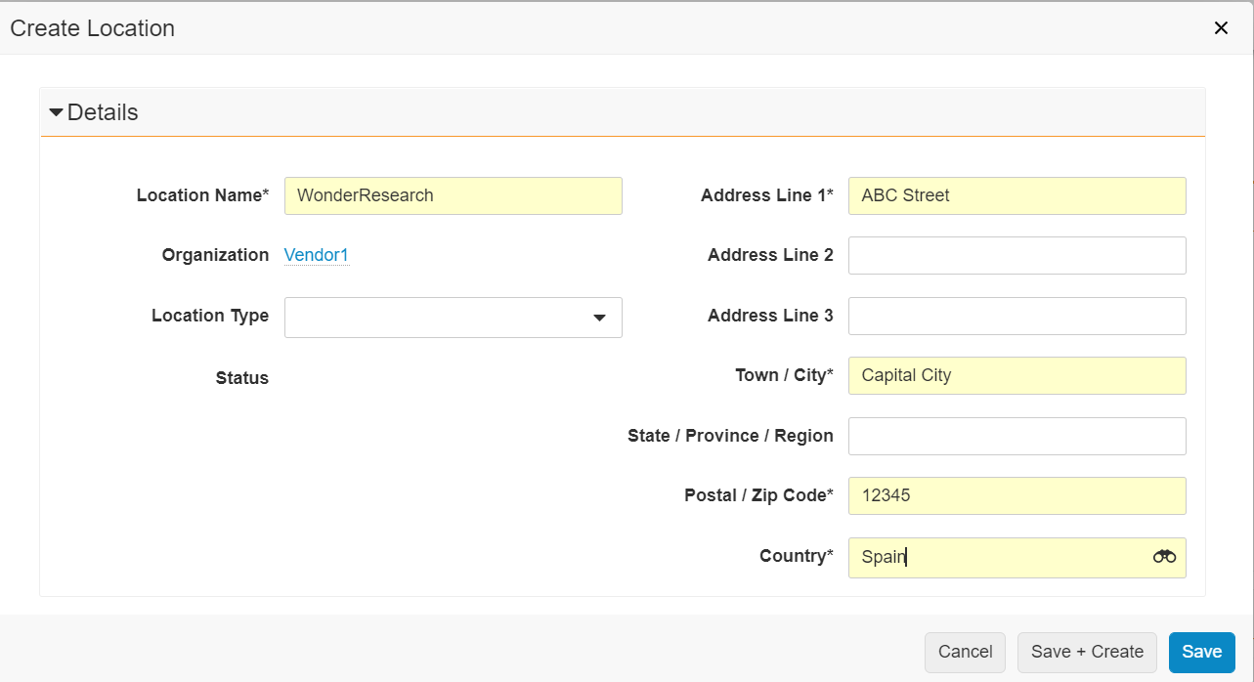
Create an Organization's Locations
2
Navigate to the Organization’s page and click on Locations in the navigation pane.
Click +Create.
Populate the required Location Name and Address fields and any other optional fields. Click Save.
Note: to continue creating locations under the same Organization, click Save + Create to open a new creation page.
1
2
3
4

Slide 16
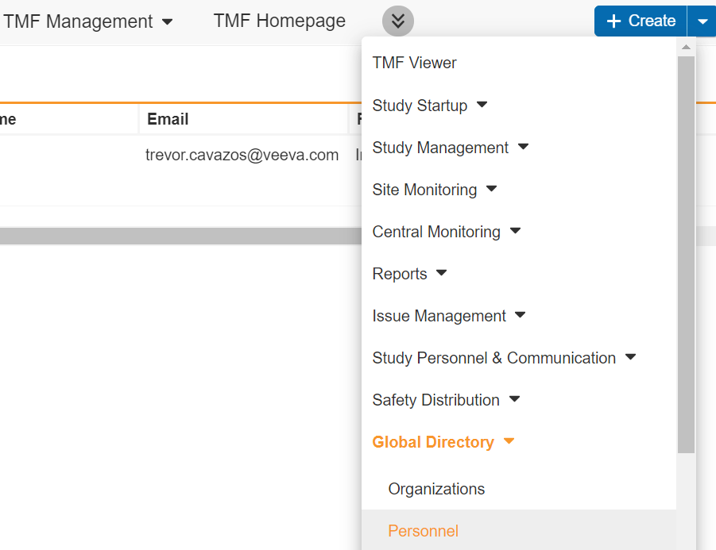
Create a Person
Navigate to the Global Directory tab, and select Personnel.
Note: the Global Directory tab may be located under the double arrows in the Navigation bar, depending on the user’s page setup.
Ensure the Person does not already exist prior to creating by searching for the person.
Note: the ‘Views’ section on the left-hand side may default to ‘Recent Personnel’ or ‘Favorites’. Ensure ‘All Personnel’ is selected when performing a search.
Note: Upon creation of a User, the system automatically creates a Person. This means that all Users are also Persons but not all Persons may be Users. You can tell which Person is also a User by reviewing the “User” column/ field
Once it is confirmed that the person does not already exist, click +Create.
1
2
3

Slide 17
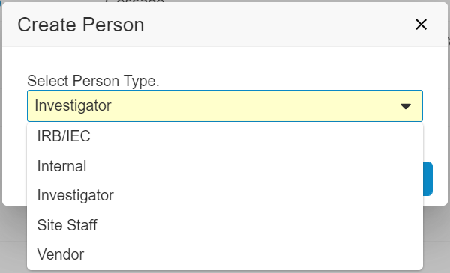
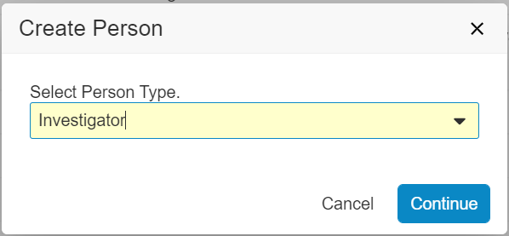
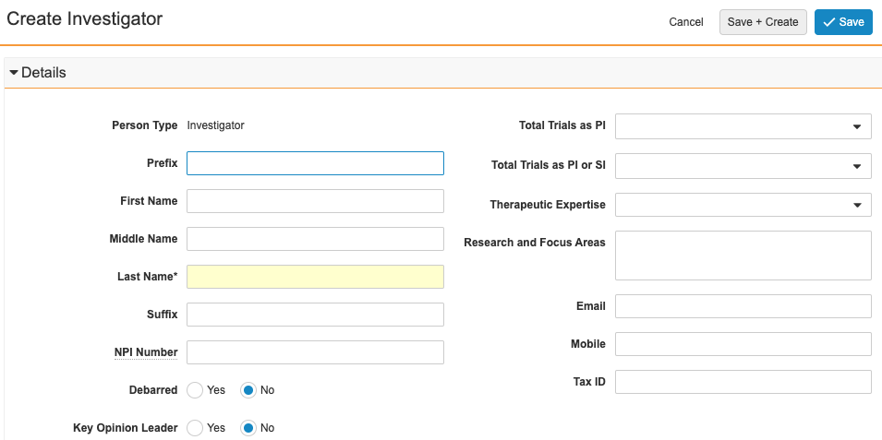
Create a Person
In the pop-up window, select the appropriate Person Type.
Click Continue.
Populate all required fields and any other applicable fields.
Click Save.
Note: This person can now be associated with studies, study countries, and study sites.
Note: A Personal Contact Information record is automatically created if the email and/or mobile field were populated. This is called Person Linked Contact Information. The Email and Phone Number fields remain in sync with those same fields on the Person page. There can only be one Person Linked Contact Information record per person.
Note: there might be different fields available depending on the Person type selected. For example, for the Investigator Person Type, there is a Therapeutic Expertise picklist field.
5
4
7
6

Slide 18
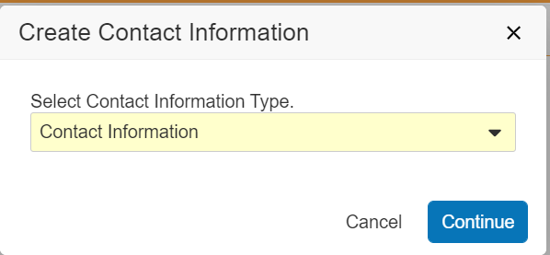
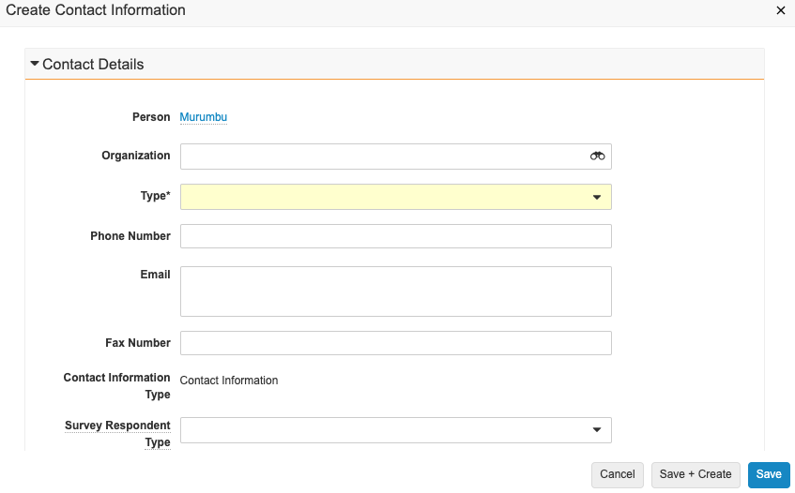
Create a Person’s Contact Information
Navigate to the Person’s page and click on Contact Information in the navigation pane.
Click +Create.
Select Contact Information as the contact information type.
Note: Person Linked Contact Information type should never be manually selected
Click Continue.
Populate the Type field and any applicable optional fields.
Click Save.
1
2
3
4
5
6

Slide 19
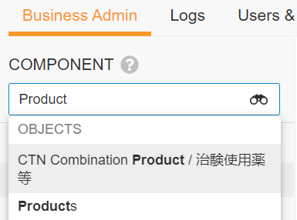
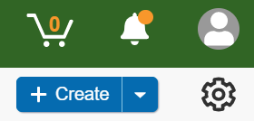
Create a Product
Navigate to the Admin area of Vault.
In Business Admin tab, click in the Component field and select Products
Verify that the Product does not exist already in Vault by searching for the product.
Note: the ‘Views’ section on the left-hand side may default to ‘Recent Products’ or ‘Favorites’. Ensure ‘All Products’ is selected when performing a search.
Once it is confirmed that the product does not already exist, click +Create.
1
2
3
4

Slide 20
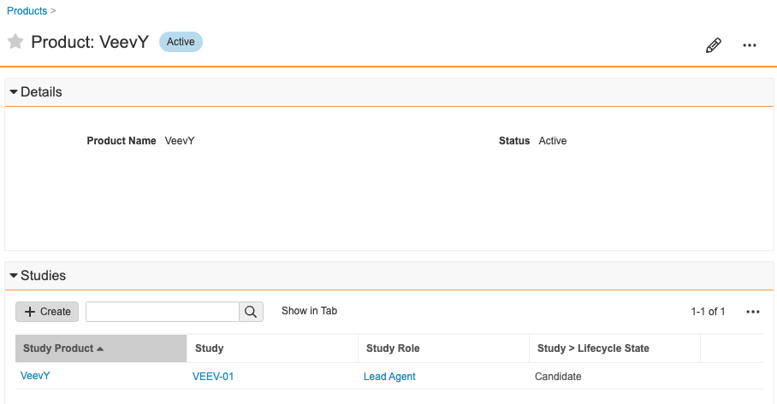
Create a Product
Enter the Product Name and leave Status field default as Active. Click Save.
The new Product’s page will be displayed.
Note: This product can now be associated with studies.
5
6

Slide 21
How to Update Reference Data

Slide 22
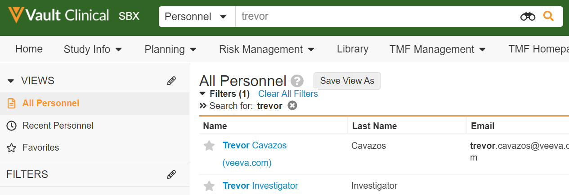
Update a Person
Navigate to the Global Directory tab, and select Personnel.
Search for the existing Person that needs to be updated.
Note: the ‘Views’ section on the left-hand side may default to ‘Recent Personnel’ or ‘Favorites’. Ensure ‘All Personnel’ is selected when performing a search.
Click on the Person Name to open the record.
Click Edit on the Person’s page.
Note: If that person is also a User in Vault, then update data from the User record (Admin > Users & Groups). When updating from the User record, data between User and Person will remain in-sync.
1
2
3
4

Slide 23
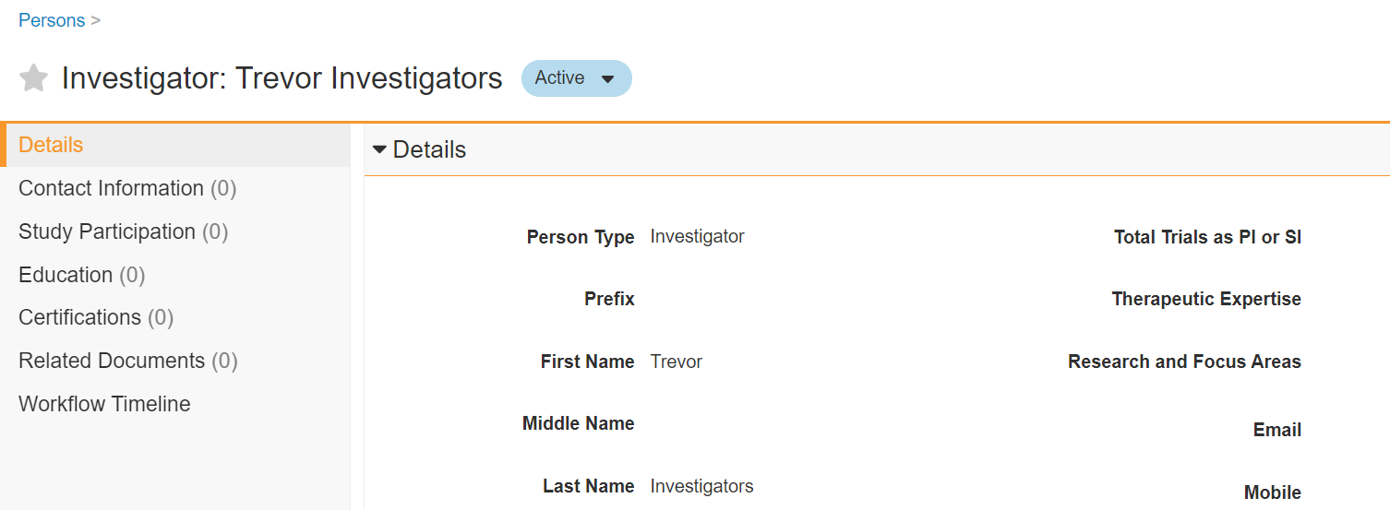
Update a Person
Locate the field(s) that require an update and update the necessary field(s).
Click Save. The Person is now updated.
Note: If the person is associated with a study, study country, or study site, the associated record will be updated.
6
5

Slide 24
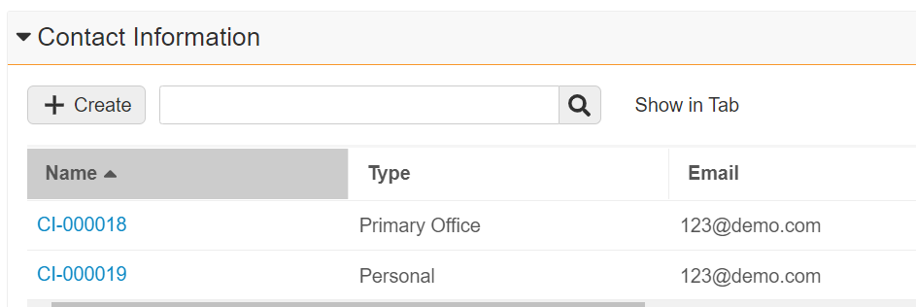
Update a Person’s Personal Contact Information
1
3
Navigate to the Person’s page
Notice that the Email populated in the Details section is the same as that noted in the Personal type record under Contact information.
Note: if Email and/or Phone Number were entered during Person creation, there will already be a Contact Information record available. This is called Person Linked Contact Information. The Email and Phone Number fields remain in sync with those same fields on the Person page.
Click Edit
Update the email address under the Details section
Click Save.
2
5
4

Slide 25
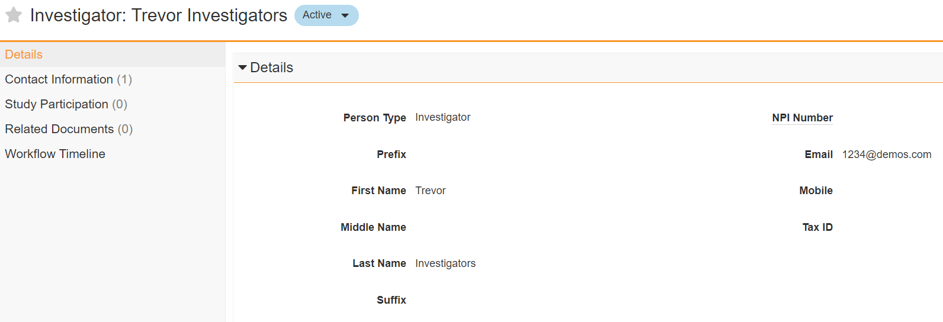
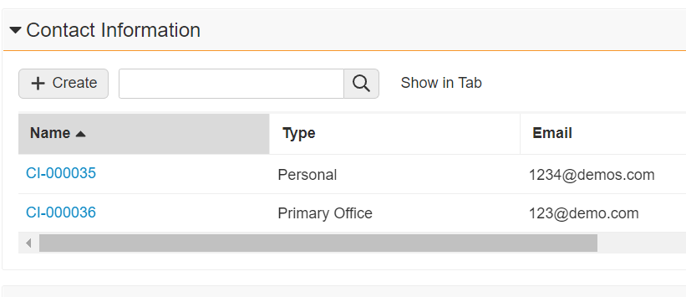
Update a Person’s Personal Contact Information
The Person Linked Contact Information is now updated.
Note: Users cannot update the Personal Type Contact Information record directly
Note: If the contact information is associated with a study, study country, or study site, the associated record will be updated
6

Slide 26
How to Inactivate Reference Data

Slide 27
Inactivate a Person
Navigate to the Global Directory tab and select Personnel.
Note: the Global Directory tab may be located under the double arrows in the Navigation bar depending on the user’s page setup.
Search for the existing Person that needs to be inactivated.
Note: the ‘Views’ section on the left-hand side may default to ‘Recent Personnel’ or ‘Favorites’. Ensure ‘All Personnel’ is selected when performing a search.
Click on the Person Name to open the record.
Click the Workflow and State Change Icon and select Make Inactive. The person is now inactive.
Note: in cases of investigator debarment, it is recommended to update the Debarred field to Yes when inactivating the investigator person.
Note: if the person was associated with studies, study countries, or study sites, related records should also be updated with End Dates. Those related records will be unaffected by this update.
1
2
3
4

Slide 28
Inactivate an Organization
Inactivate an Organization
Amy Admin received a ticket to inactivate an existing Organization due to a company merger. She will eventually need to create a new Organization to represent the new company.
How can Amy inactivate this organization in Vault?

Slide 29
Inactivate an Organization
Navigate to the Global Directory tab and select Organizations.
Search for the existing Organization that needs to be inactivated.
Note: the ‘Views’ section on the left-hand side may default to ‘Recent Organizations’ or ‘Favorites’. Ensure ‘All Organizations’ is selected when performing a search.
Click on the Organization Name to open the record.
Click the Workflow and State Change Icon and select Make Inactive.
The organization is now Inactive.
Note: if the organization is associated with a study, study country, or study site, related records should also be updated with active records as applicable. Those related records will be unaffected by this update.
Note: If organization is used as a document field, the organization will no longer be searchable in the library.
Note: any locations that exist under this organization will also be made inactive.
Note: Consider who should be able to edit fields on Inactive records
1
2
3
4
5

Slide 30
Creating a Study
Good Vault Practices

Slide 31
Content Outline
How to Create a Study
Create a Study
Create a Study Product
Create a Study Organization
Create a Study Country
Create a Study Site
1
2
How to Assign a Person to a Study
Granting Access to a Study
Tracking Study Participation

Slide 32
How to Create a Study

Slide 33
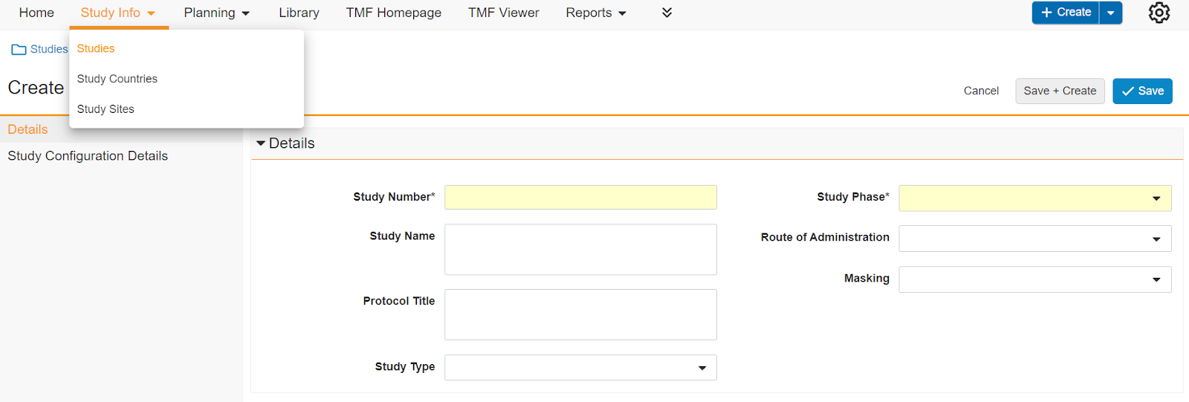
Setting up a Study
Create a Study
Navigate to Study Info tab and select Studies from the dropdown
Click the Create button. The Create Study window appears
Populate mandatory fields (highlighted in yellow)
Note: At this time, consider populating the Milestone Master Set and Template EDL fields. By default, there is only 1 option for each field. These fields will determine all future expected documents and milestones. These fields will be required later.
Click Save
The Study is created in Candidate state
Note: the Lifecycle State is always displayed in a light blue box on the top of the page. The Study Lifecycle is displayed in the Lifecycle Stages Chevron panel
2
1
4
3
5
For more information on Lifecycle Stages, Visit Vault Help: Lifecycle Stages

Slide 34
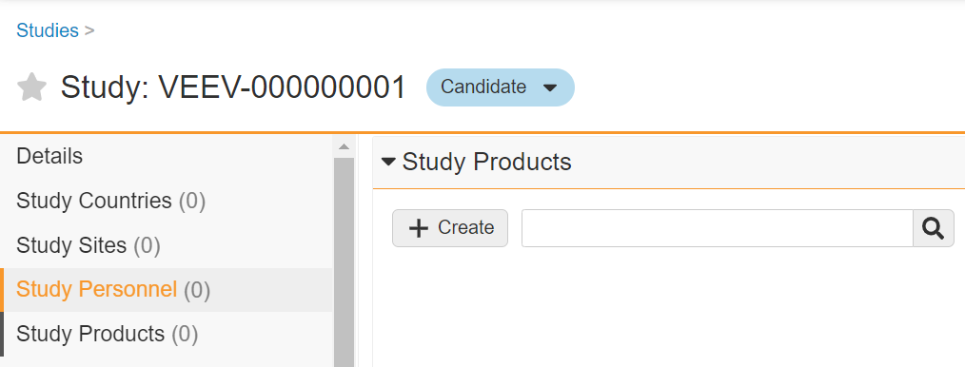
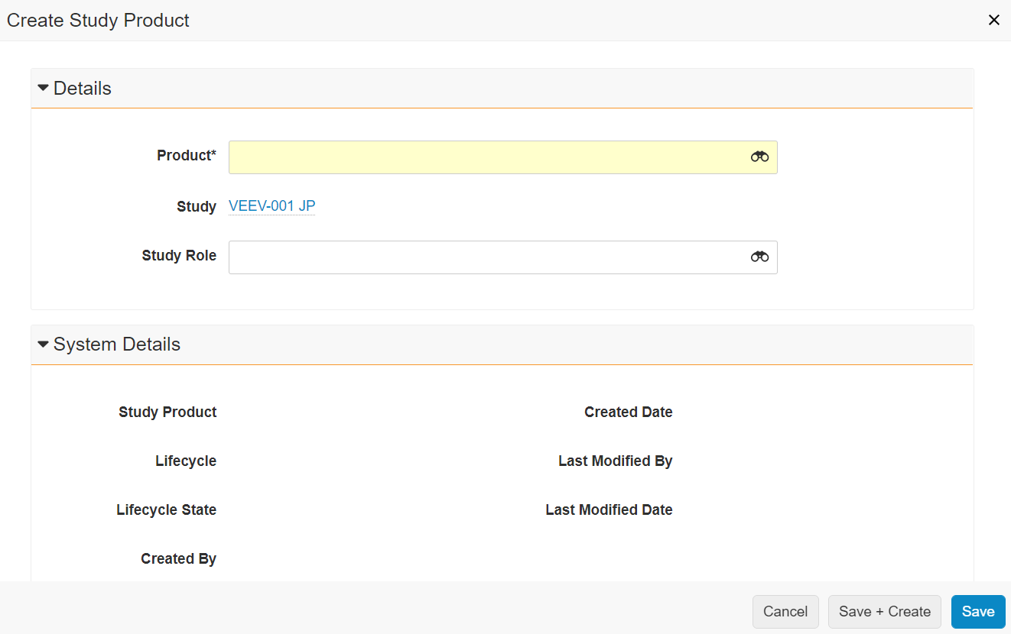
Setting up a Study
Create a Study Product
On the Study page, click on Study Products in the Navigation Pane
From the Study Products section, click Create
Select a Product and a Study Role (if applicable)
Note: Products with the Study Role of Lead Agent will be automatically included in the metadata of the documents for that study
Click Save
The Product is now associated with the Study
7
6
8
10
9

Slide 35
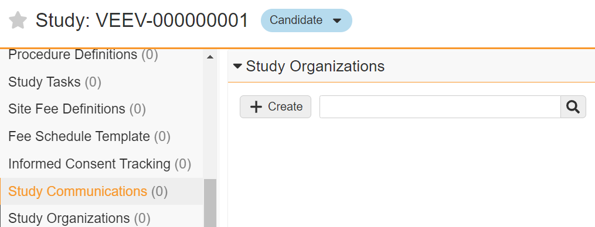
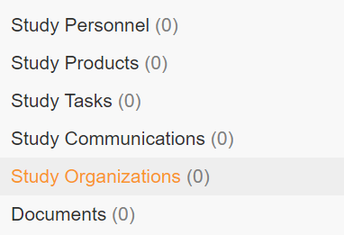
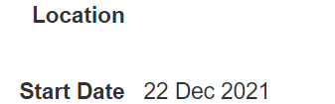
Setting up a Study
Create a Study Organization
Click on Study Organizations in the Navigation Pane
From the Study Organizations section, click Create
Select Study Organization Role
Select the Organization and a Start Date
Note: If the organization is specifically associated to a Country or Site, then populate the Study Country and/or Study Site fields
Note: Once the organization is selected the list of tracked locations for that organization in the Global Directory will be available for selection in the Location field.
Click Save
The organization is now associated with the Study
12
11
14
13
15

Slide 36
Setting up a Study
Create a Study Country
Navigate back to the Study page and click on Study Countries in the Navigation Pane
From the Study Countries section, click Create
Select a Country and populate additional metadata as needed
Click Save
The Study Country is created in the Candidate state
Note: Study Country Name and Country Abbreviation are auto-populated based on Country selection
16
17
19
18
20

Slide 37
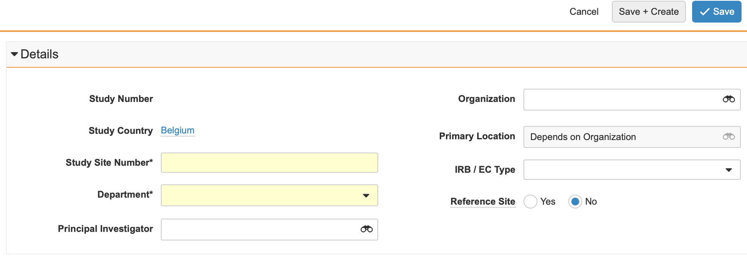
Setting up a Study
Create a Study Site
On the Study Country page, click on Study Sites in the Navigation Pane
From the Study Sites section, click Create
Populate Study Site Number, Department and add additional metadata as needed like Organization and Primary Location
Note: While possible to add a Principal Investigator at this time, once a PI is created as a Study Person, this field will automatically be updated. This process is shown in the following sections
Reference site: This gives you the ability to designate one site per study or study country as the reference site. This allows you to update the Requiredness, # Expected and other custom fields on the other sites within the study/country at the same time as the reference site.
Click Save
The Study Site is created in Candidate State
21
22
24
23
25

Slide 38
How to Assign a Person to a Study

Slide 39
Key Considerations
Vault Users vs Personnel
Granting Study Access vs Tracking Study Participation
When a User is created in Vault, a Person record is automatically created
Person records can also be created for any non-Vault Users
(E.g.: user = person; E.g.: a CTA who has access to Vault to view documents and data)
Any Person record can be associated with a Study as a Study Personnel record
(E.g.: person ≠ user; E.g.: a PI who does not have Vault access)
Study Permissions are provided via a Study Personnel record
A User is never associated with a Study
When “Grant Access to Related Records” = “Yes” then Study Permissions are granted
When “Grant Access to Related Records” = “No” then no Study Permissions are granted
Tracking Study Participation also takes place via a Study Personnel record
Consider who should be able to grant permissions vs who should be able to track study participation. Veeva recommends only System Administrator, Business Administrator, or Study Administrator (as designated in associated SOP) granting permissions, as Vault is a validated system and granting access would need to be done in alignment with the associated SOP (E.g.: to ensure appropriate training has been completed before granting access)

Slide 40
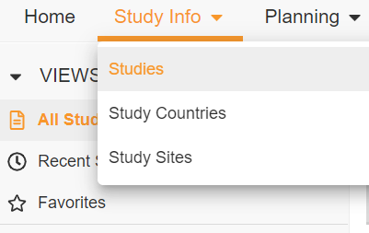
Granting Study Access
For those who need access to eTMF
Create Study Personnel
From the Study Info tab, select Studies from the drop down
Click on the blue hyperlink for study number
Note: Ensure the All Studies view is selected
On the Study page, click on Study Personnel in the Navigation Pane
From the Study Personnel section, click Create
1
2
4
3

Slide 41
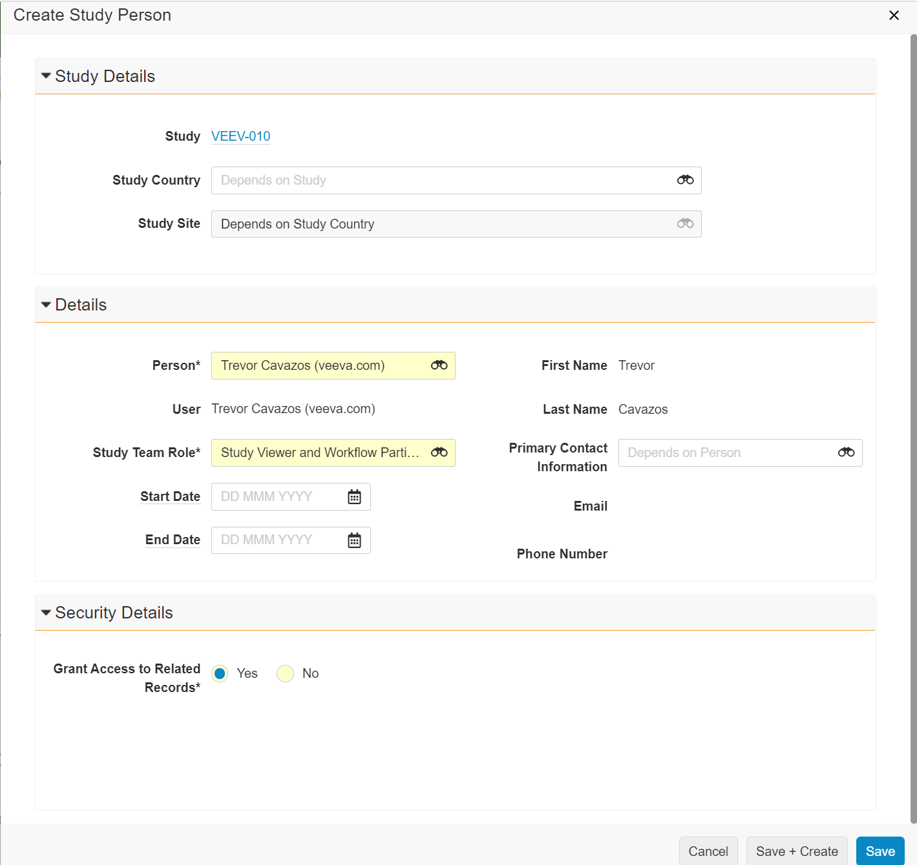
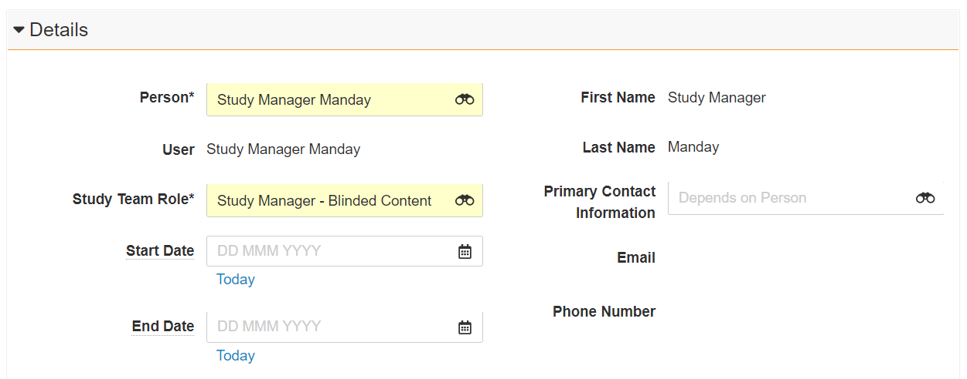
Granting Study Access
Create Study Personnel
Select the Person, Study Team Role and Start Date
Note: If the Person is also a User, the User field will automatically populate. This indicates you can provide permissions and access to this Study, if desired
Note: It is VCU process to add yourself as a Study Person upon creation of the Study.
Note: If this is a Study Country or Study Site specific role, the Study Country and Study Site fields must also be populated
Select the Primary Contact Information
Note: use the Binoculars to select the appropriate Contact Information if more than one is available for the Person. Email and Phone Number will automatically populate based on the Primary Contact Information selected
Select Yes in Grant Access to Related Records
Note: Selecting Yes to Grant Access to Related Records will grant additional permissions and access to this Study
Click Save. The Person has been added to your Study Roster with permissions
6
5
7
8

Slide 42
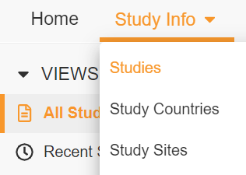
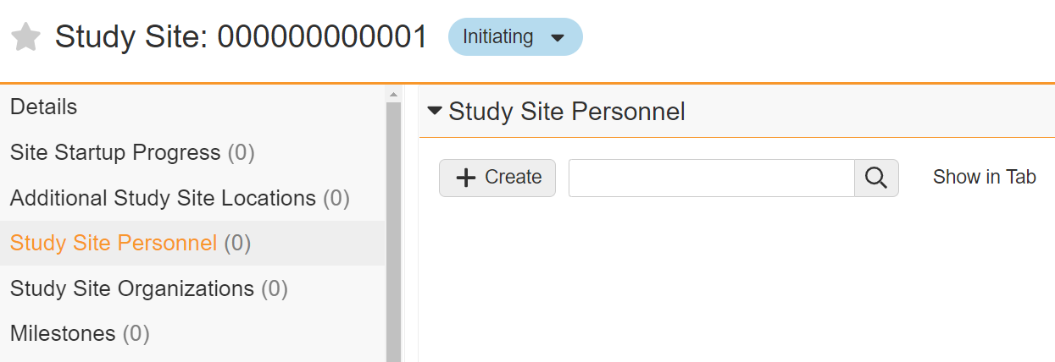
Tracking Study Participation
For those who don’t need access to eTMF but just need to be listed in the study
Create Study Personnel
From the Study Info tab, Select Study Sites from the drop down
Click on the blue hyperlink for the correct Study Site
Note: Ensure the All Study Sites view is selected
On the Study Site Page, go to the Study Site Personnel section in the Navigation Pane
From the Study Site Personnel section, click Create
Note: It is possible to create Study Site Personnel from the Study Page by going to the Study Details section and populating the Study Country and Study Site fields.
1
2
4
3

Slide 43
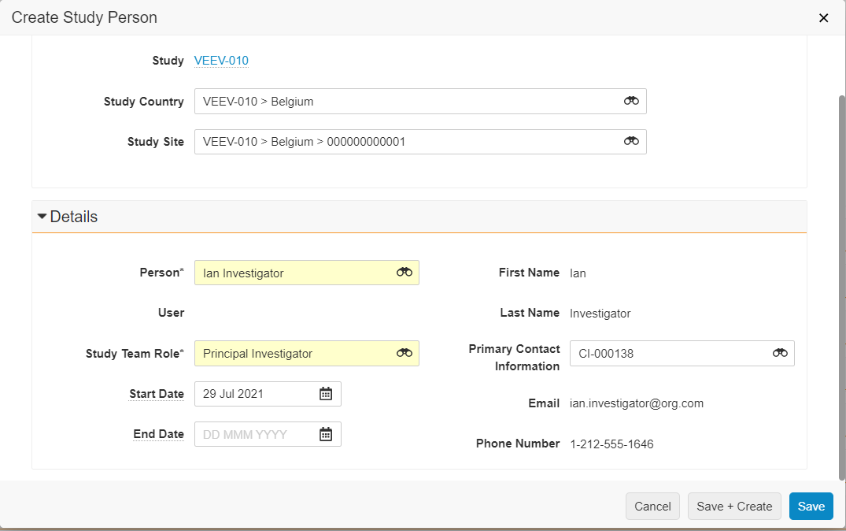
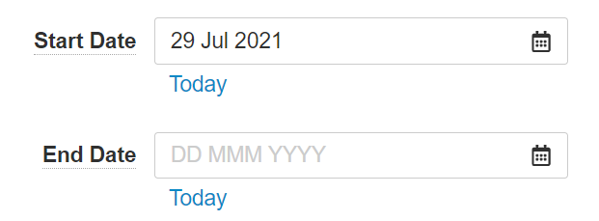
Tracking Study Participation
Create Study Personnel
Populate Person, Study Team Role and Start Date
Note: If the Person is also a User, the User field will automatically populate. Since the PI will not have access to Vault, it is expected to remain blank
Select the Primary Contact Information
Note: use the Binoculars to select the appropriate Contact Information if more than one is available for the Person. Email and Phone Number will automatically populate based on the Primary Contact Information selected
Note: Security Details section is not visible because the User field is blank. Grant Access to Related Records will default to No
Click Save + Create to add the next investigator. Repeat steps 5-7
5
6
7

Slide 44
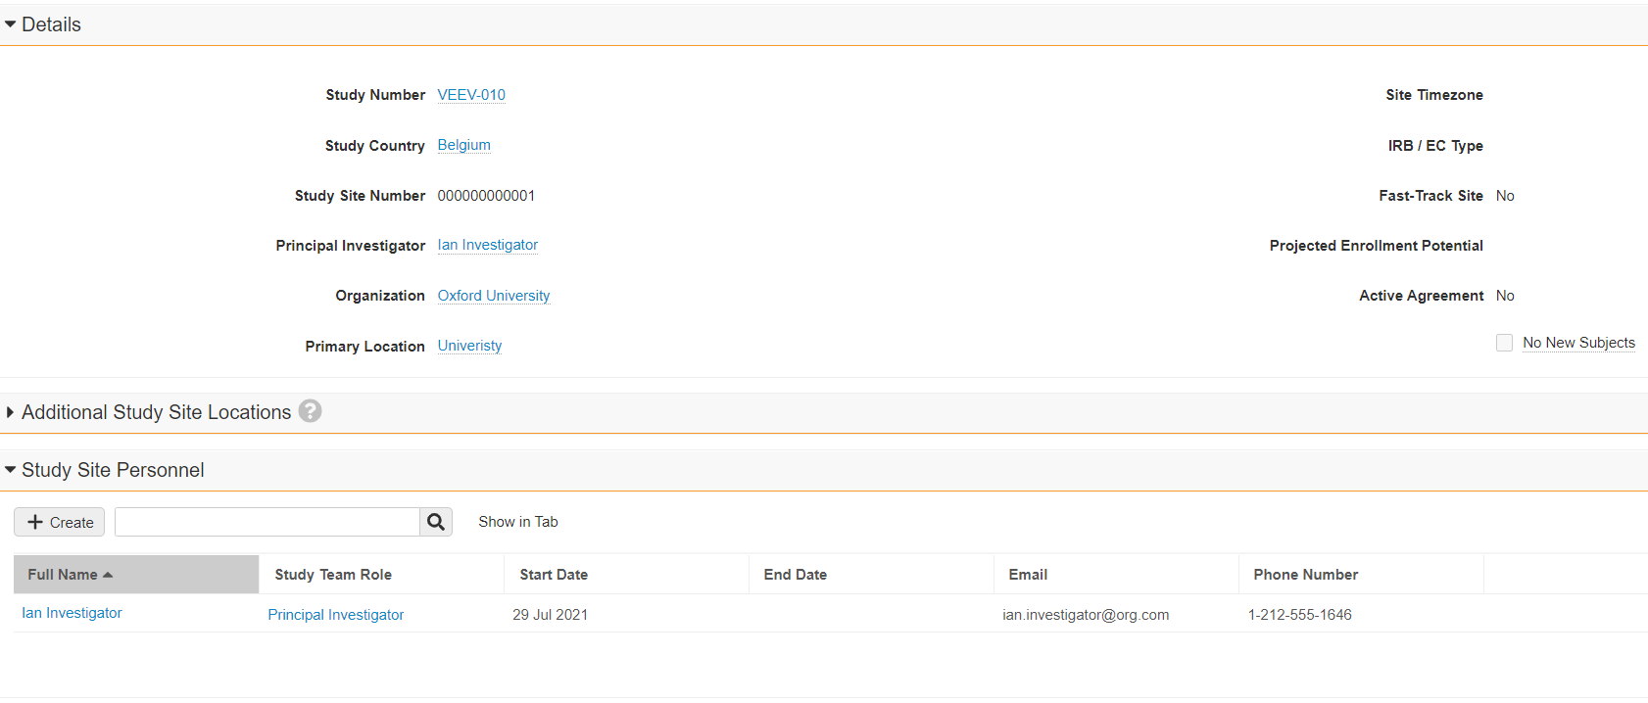
Tracking Study Participation
Create Study Personnel
The Person(s) has been added to your Study Roster
Note: You will receive an error message (examples shown on the right) if you attempt to grant access where the Study Team Role and supplied metadata do not match; or if the person selected is not a Vault user.
Adding a person with Study Team role of ‘Principal Investigator’, will also automatically set the Principal Investigator for that Study Site
Note: When creating the PI from the Study Personnel, the person selected needs to be an investigator. If not, the Principal Investigator field will not update at the site level
Note: If the Principal Investigator should change for a Study Site, Vault will update the Principal Investigator field whenever a new Study Person with the role of Principal investigator is created.
Note: Additionally, if the Principal Investigator field is updated and a corresponding Study Person does not exist, Vault creates a Study Person record with the role of Principal Investigator.
Note: it is possible to have more than one PI in a Site
8
9

Slide 45
Plan Initial Trial Requirements
Good Vault Practice

Slide 46
Content Outline
How to Initiate a Study
How to move a Study to Planning
Create Study Arms, Study Cohorts, and Visit Definitions
How to plan Milestones
How to move a Study Country and Study Site to Initiating
How to indicate a Site is Qualifying, On Hold, or Not Selected
1
How to Plan Subject Recruitment
How to review recruitment details
How to enter planned recruitment numbers
How to plan subject recruitment over time
2

Slide 47
Touchpoints to Initiating your Trial in Vault
Study, Study Country, and Study Site States
Milestones & Expected Documents
Visit Definitions
Required to be defined at Study level before subject visits can be tracked in Vault.
Later, these visits can be tied to expected visits that a subject will attend and monitoring visits.
Example Definition:
Screening
Randomization
Follow Up #1
Moving your Study, Study Countries, and Study Sites to the Planning and Initiating states allows you to track the status of your Study at each level.
Initiating your Study, Study Countries, and Study Sites will generate the first set of milestones for tracking key dates. It will also generate the initial set of expected documents.
Milestones are used for planning, tracking, and completing the activities required to appropriately manage a clinical trial.
Expected Documents can be used to measure TMF Completeness by planning for documents you expect to collect during a clinical trial.
Milestones are also used to drive Metric calculations over time.

Slide 48
Best Practices
Study, Country, & Site Selection and Planning
Study, Study Country, Study Site Lifecycle States | Milestones | Expected Documents
Study, Study Country, and Study Site are manually moved into the Planning and Initiating states respectively (Standard). Milestones are automatically created Move your Study to the Planning state before moving Study Countries to the Initiating state Move your Study Country to the Initiating state before moving Study Sites to the Initiating state All relevant Milestones should be complete before moving the Study, Study Country, or Study Site to the next state | Add Planned Finish Dates when a Milestone is first created. Baseline: original thinking. Does not change throughout a study Planned: current thinking. Updated as needed throughout a study Actual: the date the event took place/ was completed Entering a Planned Finish Date for one Milestone, will populate downstream milestone’s planned finish dates automatically and automatically change the state of the milestone Planned and Actual dates should be reviewed and updated as study events take place | When initially created, Expected Documents will have a Requiredness, # Expected, and Department value set from a Template A Reference Site within a Study Country can be used to tailor expected documents for that Site, push that Expected Document plan out to existing Sites, and use the Reference Site as the basis for Expected Documents subsequently created at Sites within that Country When initially created, review and update the Requiredness value and # Expected value based on the needs of your study Requiredness and # Expected should be evaluated and updated throughout the lifetime of your study It is important to remember that an Expected Document at one level maintains the same # Expected and Requiredness across all Milestones

Slide 49
How to Initiate a Study

Slide 50
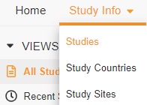
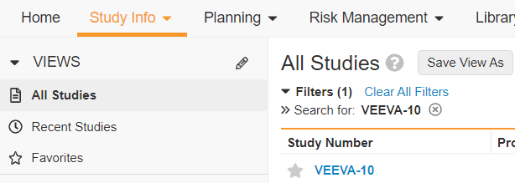
Plan the Study
From the Study Info tab, Select Studies from the drop down
Click on the blue hyperlink for Study Number
Note: Ensure the All Studies view is selected
On the Study page, click on the Workflow Action Menu icon
Select Plan Study
1
2
3
4

Slide 51
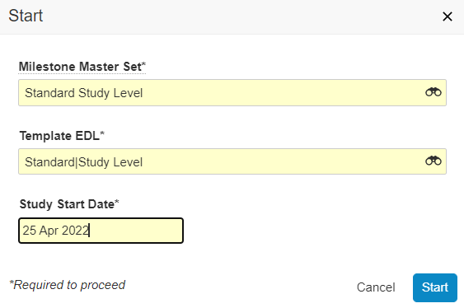
Plan the Study
Select the Standard Study Level in Milestone Master Set
Select the Standard|Study Level in Template EDL
Choose the Study Start Date
Click Start
Note: The Study will move from the Candidate to Planning state
Note: Milestones have been automatically generated in the Unplanned state
Click on Milestones in the Navigation Pane
Note: The Study Start milestone is automatically completed with dates entered in previous step
Note: Click on the Sequence column to place the milestones in a more timeline driven order (if the Sequence field is not available it can be added by clicking on Edit Columns)
5
6
7
8
9

Slide 52
Plan Milestones
From the Study, expand the Milestones section
Double click on the Planned Finish Date field of the First Study Site Initiated milestone
Note: When the planned date is updated, the baseline date will remain as the first value entered
Select a Date in the calendar and hit Enter
Note: When you hit Enter while inline editing, you will be taken to the row below and the Baseline Finish Date will auto-populate. If you hit Tab, you will be taken to the next column
The Baseline Finish Date and Planned Finish Date for the related IR milestone will be populated. The page might need to be refreshed.
Note: The Inspection Readiness Milestone is automatically planned to be 30 calendar days after the Clinical timepoint milestone. This represents a 30-day window to collect all documents required in eTMF after that Clinical Milestone
Repeat steps 2-3 for additional Planned Finish Dates
1
2
3
4

Slide 53
Plan Milestones
Click on the IR – First Study Site Initiated Milestone and open it
Navigate to the Clinical User Tasks section
Review the Clinical User Tasks and update the Assigned To and Requiredness Fields by double clicking in the column
6
7
8

Slide 54
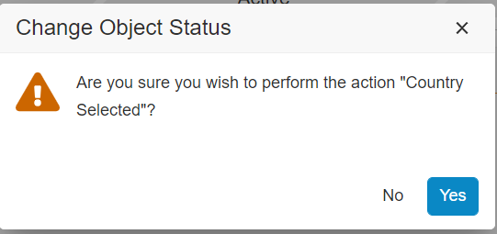
Plan the Study Country
On the Study page, navigate to the Study Countries Section
Select the Study Country name
On the Study Country page, click on the Workflow Action Menu and click Country Selected
Verify the change in Object Status and click Yes
Note: The Study Country will move from the Candidate to Initiating state
1
2
3
4

Slide 55
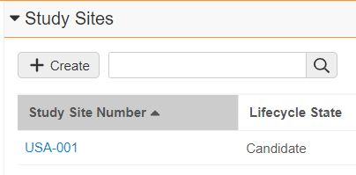
Plan the Study Country
Click on Milestones in the Navigation Pane
Note: The IR – First Country Site Initiated milestone is present
As done in the previous exercise, enter Planned Finish Dates into each Milestone
Navigate to the Study Sites Section
Select Study Site Number
5
6
7
8

Slide 56
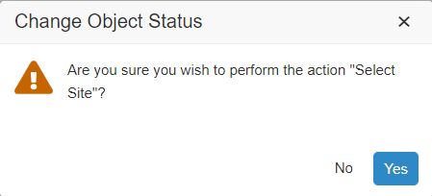
Plan the Study Site
From the Workflow Action Menu, click Select Site
Verify the change in Object Status action and click Yes
Note: The Study Site will move from the Candidate to Initiating state
Click on Milestones in the Navigation Pane
Note: The IR - Site Initiated milestone is automatically populated
Note: Click on the Sequence column to place the milestones in a more timeline driven order (the Sequence field can be added by clicking on Edit Columns if not available)
As done in the previous exercise, enter Planned Finish Dates into each Milestone
9
10
11
12

Slide 57
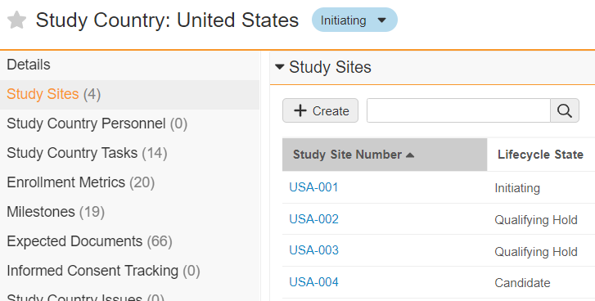
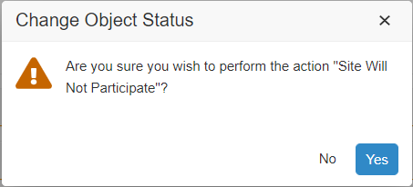
Move Candidate Site to Not Selected
Return to the Study Country, and select a Candidate Study Site Number
On the Study Site page, click on the Workflow Action Menu and select Site Will Not Participate
Note: This action will set the milestones and dependencies to inactive. However, it is possible to re-evaluate a site from not selected. In this scenario the milestones / dependencies are not re-activated automatically, an admin would need to reactivate the milestones and dependencies
Verify the change in Object Status and click Yes
The Study Site will move from the Candidate state to the Not Selected state
1
2
4
3

Slide 58
How to Review and Update Expected Documents

Slide 59
Benefits of Milestones and Expected Documents
Using Expected Documents in Vault allows you to set pre-determined lists of documents that commonly need to be filed or updated throughout a Study
Using Milestones in Vault allows you to plan and track Study-related activities, measure cycle times, and quickly understand the impact of events (e.g., protocol amendments)
Periodically updating Expected Documents requiredness and # expected will help accurately track how complete your TMF is and help quickly identify where documents may be missing
Defining a Reference Site for your Study Country and using that as a baseline to push the updates to the rest of the Sites

Slide 60
Working with Expected Documents in Vault
Individual Expected Document Update
Update Expected Documents in Bulk
Update Related
Expected Documents
Update a single Expected Document’s Requiredness and/or number of Expected Documents
Update many Expected Documents at the same time
Tailor Expected Documents for a Reference Site and push the Expected Document plan out to existing Sites
Action it from the Expected Documents tab
Use an individual Expected Document to “copy and paste” the Requiredness and/or # Expected to other countries or all sites’ Expected Documents

Slide 61
Best Practices
Update Expected Document’s Requiredness and # Expected
Best Practice Guidance | Best Practice Guidance
Method | Purpose | Use Case | Applicable Level
Update Expected Documents for all Sites Under a Country | Use a Site as a Reference Site within a Country to roll out the Expected Document plan to all other Sites. Newly selected sites will get the expected documents updated to match the reference site. | Within a Country, all Sites can have the same Expected Documents plan, including Requiredness and # Expected | All Sites within a Country
Update Expected Documents in Bulk | Update many Expected Documents at the same time using a Bulk Action | Filter, review, and update a Site’s Expected Documents from Pending Decision to Required | Study, Country, and Site
Update Related Expected Documents | Use an individual Expected Document to “copy and paste” the Requiredness and/or # Expected to other countries or all sites’ Expected Documents | Within a Country, all Sites will only have one submission. Update ‘Other Approval’ Expected Document to Not Required for all sites in a country | All Countries or all Sites
Individual Expected Document Update | Update a single Expected Document’s Requiredness and/or # expected value | Set the ‘Investigator Brochure’ Expected Document to Required. The # Expected will automatically adjust to 1 | Study, Country, and Site

Slide 62
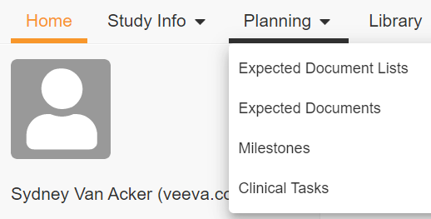
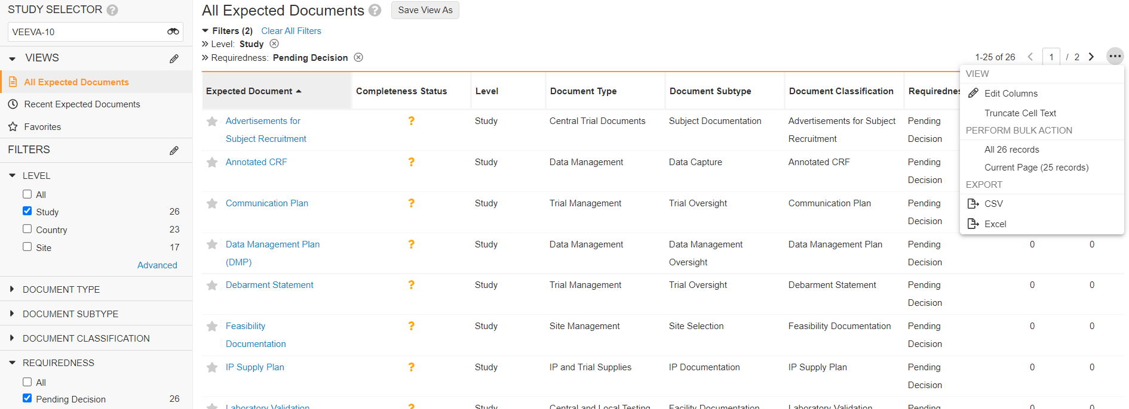
Update Expected Documents in Bulk
From the Planning tab, Select Expected Documents from the drop down
From the Study Selector, select your Study
From the Filters panel, select Pending Decision on the Requiredness filter and select Study on the Level filter
Once filtered, click on the Ellipses and under Perform Bulk Action, click All records
1
2
4
3

Slide 63
Update Expected Documents in Bulk
6
From the Refine Selection page, review the list of selected Expected Documents and deselect any that you do not want to include in the bulk edit
Click Next
Note: All selected Expected Documents will be set with the same Requiredness and/or # Expected via this bulk action
From the Choose Action page, select Edit Fields
Click Next
5
8
7

Slide 64
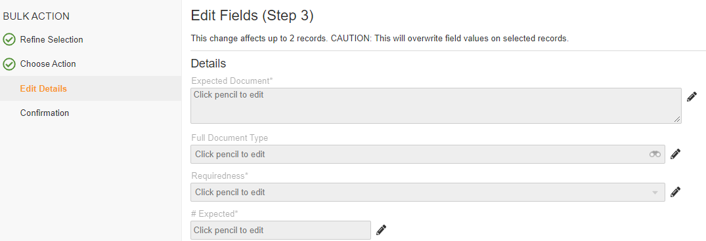
Update Expected Documents in Bulk
From the Edit Fields page, click on the Pencil icon next to the Requiredness field
Set Requiredness to Required
Note: The number of expected will automatically change to 1 with this step
Select Next
9
11
10

Slide 65
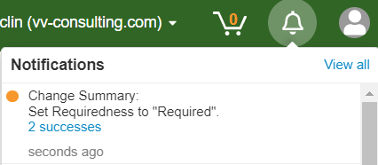
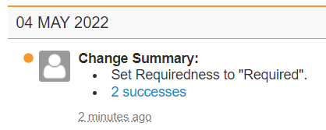
Update Expected Documents in Bulk
From the Confirmation page, review the summary of changes and click Finish
Note: A yellow banner will be displayed on top of the page when the bulk updates start
Click on Notifications icon, then click on View all
You will see a Change Summary notification and you will receive an email when the processing is complete
12
13

Slide 66
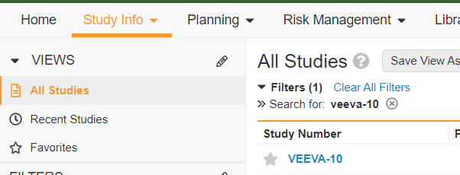
Individual Expected Document Update
From the Study Info tab, Select Studies from the drop down
Click on the blue hyperlink for Study Number
Note: Ensure the All Studies view is selected
On the Study page, click on Study Countries in the Navigation Pane
Click on the blue hyperlink for the Study Country Name
1
2
3
4

Slide 67
Individual Expected Document Update
On the Study Country page, click on Expected Documents in the Navigation Pane
Use the search box on the Expected Document section to find the Expected Document
Double click on the Requiredness column and select Not Required
Note: The # Expected will automatically change to 0
Note: This process should be repeated until all Expected Documents reflect what should truly be collected in your trial
6
5
7

Slide 68
Update Related Expected Documents
Use Cases and Roles
Lead CRA Lucy has been assigned to a country in a new Study. For all the sites in the country, the only approval needed is the IRB/IEC Approval
How can Lucy indicate in Vault that Other Approvals are not required for any of the sites in the country?
Note: Lead CRA Lucy should have been added as Study Personnel and granted access during the Create a Study GVP. This step needs to be completed to allow Lucy perform study activities based on her role.
Note: This scenario should be used when a Reference Site is not being utilized for a Country or when one Expected Document changes the requiredness or number of expected for all sites (including the reference site).

Slide 69
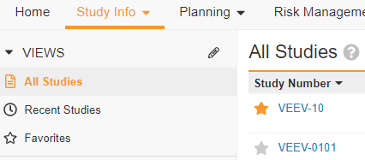
Update Related Expected Documents
From the Study Info tab, Select Studies from the drop down
Click on the blue hyperlink for Study Number
Note: Ensure the All Studies view is selected
On the Study page, click on Study Sites in the Navigation Pane
Click on the blue hyperlink for any Study Site Number
1
2
3
4

Slide 70
Update Related Expected Documents
On the Study Site page, click on Expected Documents in the Navigation Pane
Use the search box on the Expected Document section to find the Expected Document
Double click on the Requiredness column and select Not Required
Note: The # Expected will automatically change to 0
6
7
5
7

Slide 71
Update Related Expected Documents
Hover over an Expected Document with Related Expected Documents and click on the Ellipses
Select Update Related Expected Documents
Select an option in the new window
Note: You can update expected documents for all Study Sites in the same Study or same Study Country
Click Continue
Note: A yellow banner will be displayed on top of the page when the bulk updates start
Note: Vault will now “copy and paste” the values you update for Requiredness and # Expected for one site, across all Study Sites in that Country
9
8
10
11

Slide 72
Managing Your Trial in Vault
Good Vault Practices

Slide 73
Content Outline
How to Activate a Study, Study Country, and Study Site
How to activate a Study
How to move a Study Country and Study Site to Active
How to activate Several Study Countries and Sites at once
1
How to Update a Study Person
How to add Person specific expected documents
2
How to Manage Protocol Amendments
3
How to Complete Milestones
4
How to Track Study Communication
5

Slide 74
Touchpoints for Managing your Trial in Vault
Study, Study Country, and Study Site States
Milestones & Expected Documents
Study Communication
Log
Ad Hoc
Events
Study Personnel
Moving your Study, Study Countries, and Study Sites to Active allows you to track the status of your Study at each level.
Activating your Study, Study Countries, and Study Sites will generate new milestones for tracking important dates. It will also generate new expected documents.
Create and maintain study rosters to track the start and end dates for personnel working on each study.
Admins can grant and remove study access to users with study person records.
Ad Hoc Events can help plan for unscheduled events during a study.
There is one type of Study Level Ad Hoc Event:
Protocol Amendment
Ad Hoc Events create new Milestones for tracking relevant dates and document collection.
Milestones are used for planning, tracking, and completing activities required to manage a clinical trial.
Expected Documents can be used to measure TMF completeness and timeliness by planning for documents you expect to collect
Vault can create person, product, and organization specific Expected Documents for more granular tracking
Communication Logs allow tracking of communications for a Study, Study Country or Study Site. There are 3 communication types:
Ingested Email: created when an email is sent to Vault. The contents become an unclassified document, is associated to a Study and is ready for manual classification.
Site Communication: to track communications with site personnel regarding site related important information or activities.
Other Communication: used for all other types of study-related communications at all levels.

Slide 75
Best Practices
Managing Your Trial in Vault
Best Practice Guidance
Moving Study, Study Country, Study Site to Active | Study Personnel | Milestones | Expected Documents | Ad Hoc Events | Study Communication Log
Complete all relevant milestones before moving the Study, Study Country, or Study Site to the next state Study, Study Country, and Study Site are manually moved into the Active state (Standard). Milestones are automatically created The Legacy action for “Create Milestones from Template” should not be used | Use Start Date field on your Study Person records to maintain accurate records of study participation. Use End Date field on your Study Person to track the end of study participation while the study is ongoing. The ‘Make Inactive’ action that inactivates a Study Person and populated the end date should only be used for study personnel without person-specific documents (if a study person is inactivated and the document is up versioned, the study will no longer be added to the document!) | Review and update Planned and Actual milestone dates throughout the Trial. Do not update Baseline dates after setting them initially Plan Clinical milestones first to auto-plan Inspection Readiness milestones (Ex: planning First Study Site Initiated will automatically plan IR - First Study Site Initiated") Populate Actual Finish Dates as close to real-time as possible, as this will control any milestones which auto-complete | Review and update Expected Documents throughout the trial and with the generation of any new milestone An Expected Document maintains the same # Expected and Requiredness across all Milestones because there should not be a different requirement per department/business process | Update relevant expected documents as Protocol Amendments occur For any documents that should be associated with expected documents that have owning milestones, ensure the owning milestone field is populated on the document appropriately | Create the Study Communication Log as communications happen to replace external team trackers The Clinical Email Ingestion feature supports inbound email addresses which can create a TMF document from an inbound message. This can then be related to a Study Communication Log record Run a communications report in lieu of uploading correspondence

Slide 76
Key Considerations
Activation Order of Studies, Study Countries, and Study Sites
Trial Management Tools
The following trial management tools pull information from different areas of Vault into a single page:
Should Study and Study Country move to Active only after the first Study Site becomes Active?
CRA Homepage – displays key information for Clinical Research Associates (CRAs), including site status, enrollment metrics, and monitoring data
Study Management Homepage - displays key information including study status, enrollment metrics, and monitoring data
TMF Homepage - displays graphs that show the timeliness, completeness, and quality of your TMF documents, in addition to your tasks and upcoming milestones
When is a Site considered Active?
Define a business process for what triggers a Study, Study Country, and Study Site to become Active
Should the Study move to Active first, followed by Study Country, and then the Study Site? (This behavior is Standard in Vault)

Slide 77
How to Activate a Study, Study Country, and Study Site

Slide 78
Activate a Study
Navigate to the Study Info Tab and Select Studies
Open your Study page by clicking into its Study Number link
Confirm all relevant Milestones are complete
Note: If a milestone is not completed, populate the Actual Finish Date. This will change the lifecycle state of the milestone to Complete and update the Completeness icon
On the Study Page, navigate to the Workflow and Change State icon and choose Ready to Enroll
Note: The Study state and the Lifecycle Stage bar now say “Active”
Note: New Milestones and Expected Documents will generate in the Active state. Plan the milestones by populating Planned Finish Dates and update Expected Documents as needed for your Trial. These Steps can be found in the Plan Initial Requirements GvP.
1
2
3
4

Slide 79
Activate a Study Country
From the Study Page, navigate to the Study Countries section
Open the Study Country page by clicking into the Study Country Name link
Confirm all relevant Milestones are complete
Note: If a milestone is not completed, populate the Actual Finish Date. This will change the lifecycle state of the milestone to Complete and update the Completeness icon.
On the Study Country Page, navigate to the Workflow and Change State icon and choose First Site Initiated
Note: Both the Study Country state and Lifecycle Stage bar now say “Active”
Note: New Milestones and Expected Documents will generate in the Active state. Plan the milestones by populating Planned Finish Dates and update Expected Documents as needed for your Trial. These Steps can be found in the Plan Initial Requirements GvP.
5
6
7
8

Slide 80
Activate a Study Site
From the Study Country page, navigate to the Study Sites section
Open the Study Site page by clicking into the Study Site Number link
Confirm all relevant Milestones are complete
Note: If a milestone is not completed, populate the Actual Finish Date. This will change the lifecycle state of the milestone to Complete and update the Completeness icon.
On the Study Site Page, navigate to the Workflow and Change State icon and choose Initiate Site
Note: Both the Study Site state and Lifecycle Stage bar now say “Active”
Note: New Milestones and Expected Documents will generate in the Active state. Plan the milestones by populating Planned Finish Dates and update Expected Documents as needed for your Trial. These Steps can be found in the Plan Initial Requirements GvP.
9
10
12

Slide 81
Activate Multiple Study Countries
Bulk Action
From your Study Page, navigate to the Study Countries section
Click Show in Tab to open a page with the list of all Study Countries for your Study
On the Study Countries page, navigate to the Ellipses and choose “Perform Bulk Action >>All XX Records”
1
2
3

Slide 82
Activate Multiple Study Countries
Bulk Action
Use the checkboxes to the left to select the Study Countries you want to activate and click Next
In the checkbox to the left, select “Manage Lifecycle >> Change State” action and click Next
All selected Study Countries must be in the Initiating lifecycle state in order to move to Active
4
5

Slide 83
Activate Multiple Study Countries
Bulk Action
In the checkbox to the left, select “First Site Initiated” and click Next
Review the Summary of the changes and if correct, click Finish
6
7

Slide 84
Activate Multiple Study Countries
Bulk Action
Review and close the pop-up information banner on the top
Once the bulk updates are complete a new notification will be sent. Click on the Bell Icon and then View All to open the Notifications
On the Notifications page, review the details and status of the completed updates
Note: Use this same process to move multiple Study Sites to the Active state at one time.
8
9
10

Slide 85
Managing Study Personnel

Slide 86
Updating a Study Personnel
Inactivate a Study Person
Navigate to the Study Info tab and select Studies
Open your Study page by clicking in its Study Number link
Navigate to the Study Personnel section to expand the list of Study Personnel
Locate in the list Name of the individual who has left the Study
* It is also possible to access to the Study Personnel under Study Personnel & Communication tab
1
2
3
4

Slide 87
Updating a Study Roster
Inactivate a Study Person
Click on the Ellipses, and select Change State to Inactive
Note: If End Date is not today, then user can update End Date after making Study Person inactive
Repeat this process for any Personnel no longer working on the trial
5

Slide 88
Tracking Protocol Amendments

Slide 89
Create a Protocol Amendment
Navigate to the Study Info tab and select Studies
Open your Study page by clicking into its Study Number link
From the Ellipses select Ad Hoc Event
Protocol Amendment is defaulted. Click Continue
Navigate to the Events Section and hover over the Protocol Amendment.
1
2
3
4
5

Slide 90
Create a Protocol Amendment
From the Ellipses select Plan
Enter the Planned Start Date and Planned Finished Date and click Start
Note: These dates can also be entered into the fields directly. The milestone will become planned and change to the planned lifecycle state automatically.
Navigate to the Expected Documents Section to view and update the Expected Documents’ # Expected and Requiredness.
Note: the Requiredness and #Expected fields are synchronized. If Requiredness is set to Not required, the #Expected will be set to 0. If it is set to Required, it will be set to 1. The #Expected can be updated further.
Note: Each Protocol Amendment created will have its own set of Expected Documents created as well. This relationship is set by the ‘Owning Milestone field.’ You can search for those newly created Expected Documents in the list.
When available, begin to upload Amendment documents
6
7
8

Slide 91
Completing Milestones

Slide 92
Completing Milestones
Use Cases and Roles
Study Manager Mandy learned her site has enrolled its first subject! Mandy needs to record this important site milestone in Vault.
This is also the first subject enrolled in the country and the entire study. Mandy wants to verify that the date she entered for her site is automatically captured in the milestones for the related Country and Study.
How can Mandy complete this site level milestone and verify the upstream dependent milestones in Vault are also complete?
To learn more about Completing Milestones in Vault, review the Vault Help page for Working with Milestones

Slide 93
Completing Milestones
From the Study Info tab and select Study Sites.
Populate the Study Selector with your Study, and click into the Site
Note: Ensure “All Study Sites” is selected
Expand the Milestones section on the Study Site page and locate the Milestone to be updated.
1
2
3

Slide 94
Completing Milestones
Move the cursor over the Actual Finish Date. When the box becomes shaded, double-click to in-line edit.
Note: milestones dates can also be updated by navigating into the milestone page and clicking ‘Edit’.
Populate the Actual Finish Date and click the cursor anywhere on the page to save the value.
Note: hitting the ‘Enter’ or ‘Tab’ keys will make the next field on the page available for quick editing.
The Completeness and % Complete fields update to indicate the milestone is complete.
Note: The milestone will be updated to the Complete state automatically
Note: It is also possible to complete the milestone using the “Mark Complete” action from the Ellipses
4
5
6

Slide 95
Completing Milestones
Now that site level milestone is complete, the dates will have “rolled up” to the dependent country and study milestones. To verify this, complete the below:
From the Planning Tab, select Milestones
Filter on your Study, and then search for dependent milestones in the search bar
Verify that the dependent milestones are complete and have the proper dates based on the previous milestone.
7
8
9

Slide 96
Completing Milestone Tasks
Before completing a Milestone, ensure any Clinical User Tasks, which were created along with the milestones, have been resolved.
From the Study page, click on the milestone name to view the details
Navigate to the Clinical User Tasks section which lists all the tasks corresponding to the milestone
Each task can be resolved by clicking on the Ellipses that appears at the end of each record
Note: You can also click on the Task Name to view the task details and resolve or complete other actions for that task record
1
3
2

Slide 97
Document Inbox
Good Vault Practice

Slide 98
Content Outline
Uploading Unclassified Documents
1
Sharing the Document Inbox
2
3
Using the Document Inbox with TMF Bot
4
Using the Document Inbox

Slide 99
Uploading Unclassified Documents

Slide 100
Benefits of Using the Document Inbox
Ability to upload and classify in bulk
Collaboratively process documents through Inbox sharing
Automatically and accurately classify documents with TMF Bot

Slide 101
Key Considerations
TMF Bot
Ensure that a role has been defined via business process to monitor the Document Inbox for documents that have been classified by the TMF Bot but for which classification has not been completed.
TMF Bot and Document QC
TMF Bot can be used as an opportunity to revisit current QC processes to potentially reduce the quantity of documents and metadata that are QC’d. Additionally, misclassifications should not be reviewed in the Inbox but be part of the usual quality review process.
Now, a TMF Bot QC Check can be added as a step to any document workflow to surface possible issues with a document’s classification. Does this need to be included in any of the workflows?
Sharing the Document Inbox
Document Inbox Sharing can be enabled or disabled. If enabled, the Document Inbox can be shared with individual users or groups. Be mindful of who the documents are being shared with since it is possible to share documents with unintended users. The Document Inbox cannot be shared with more than 50 users or groups and cannot be shared if it contains more than 1,000 documents.
Monitoring TMF Bot Performance
Recommendation is to review the TMF bot performance 1-2 weeks after a new trained model being deployed
Performance should be monitored at least quarterly. Who will be responsible of this?
What should be the KPIs for TMF Bot performance? Document classification extraction coverage, Auto-classification coverage, Misclassification rate...

Slide 102
Ways to Upload an Unclassified Document
Using the Create button
Drag and Drop
Using Veeva Snap
Email to Vault
Allows users to upload or drag up to 250 documents directly to the Inbox
Bulk apply Study, Study Country, Study Site.
Veeva recommended upload method.
Upload a document into Vault in the Unclassified state and classify later
Upload a document to a Placeholder via the Authoring workflow
More information about Veeva Snap available in the "File a Document in Vault" GvP.
Automatically create documents in the Inbox via email.
To learn more about enabling this feature, visit the Vault Help page for more information.
Load a document into Vault
Classify Documents Later
Notes:
Unclassified documents are documents which have a source file, but no document type. Veeva Snap allows users to upload a document into Vault in the unclassified state. They can access and classify this document within their Document Inbox.

Slide 103
Upload via +Create Button
Using the Create Button, choose Document.
In the Create Document dialog, select Upload. Select Continue.
Drag and drop or choose document from a drive.
Up to 100 documents can be uploaded at once.
Select Classify documents later.
Select a Study, Study Country and Study Site, as applicable.
This value will apply to all documents uploaded in this batch.
Click Upload.
1
2
3
4
5
6

Slide 104
Drag and Drop
Navigate to the Document Inbox from the Library tab.
From your local drive, select the multiple documents to upload.
Drag the selected files into the document inbox.
Bulk apply the Study, Study Country, and Study Site, as applicable. Click Upload.
This value will be applied to all selected documents.
In the bottom right corner of the screen, monitor the upload progress using the Upload Modal.
The green arrow can collapse or expand the modal as needed.
The green check mark indicates that the document has completed upload.
1
2
3
4
5

Slide 105
Sharing the Document Inbox

Slide 106
Sharing the Document Inbox
From the Document Inbox, select Share Inbox.
Search for the users or groups that the Document Inbox will be shared with. Click +Add. Click Apply.
The user(s) have been added to these documents as an Inbox Editor.
As an Inbox Editor, users can update the document’s metadata and reclassify.
Reference Vault Help for more information on this feature.
1
2
3

Slide 107
Using the Document Inbox

Slide 108
Using the Document Inbox
Navigate to the Document Inbox. Select which documents need to be checked for duplicates. In the ellipses, click Detect Duplicates.
If any were detected, hover over the Duplicates Detected to locate the duplicate.
Assess the duplicate(s) detected and delete if necessary.
To classify documents in bulk, check the boxes of the intended documents. Then click Complete.
To classify a singular document, click into the document, click into the ellipses, and click Complete.
1
3
2

Slide 109
Using the Document Inbox
Select the applicable Document Type. Click OK. Populate any required fields or additional information. Click Save.
The document has been removed from the Document Inbox and place in the Library.
To reject a document, click into the document and click on the Reject Document action.
Review the notes in the dialogue box. Click Start.
The document has moved to the Rejected state.
4
5
7
6

Slide 110
Filing Documents in Vault
Good Vault Practice

Slide 111
Content Outline
How to Upload a Document
Upload with +Create Button
Upload via Expected Document
Upload via Inbound Email Address
Upload via Document Inbox
1
How to Up-version a Document
Using “Create Draft”
Using “Upload New Version”
Receiving a Task & Collaborative Authoring
2
How to Reuse Documents
Using Make a Copy
Reusing documents across Studies
3
4
Appendix
Using Document Templates

Slide 112
How to Upload a Document

Slide 113
Ways to Create a Document
Using the Create button
Using Expected Documents
Receiving a Task
Load a document into Vault
Create a document from existing template
Create a Placeholder
Allows users to upload or drag and drop a document directly from the ED record
System auto-fills certain fields based on ED item values
From a workflow
Allows the workflow owner to specify which document a user should upload at a given time
Note: This step-by-step will be reviewed in “Working with Documents” GvP
Notes:
Unclassified documents are documents which have a source file, but no document type. Veeva Snap allows users to upload a document into Vault in the unclassified state. They can access and classify this document within their Document Inbox.

Slide 114
Ways to Create a Document (Unclassified)
Send Email to Vault
Document
Inbox
Configure Vault to receive email via an inbound email address
Document will appear in Document Inbox as an unclassified document in the Incomplete state
Refer to Good Vault Practice (GvP) – Document Inbox for additional information on uploading documents via Document Inbox
Notes:
Unclassified documents are documents which have a source file, but no document type. Veeva Snap allows users to upload a document into Vault in the unclassified state. They can access and classify this document within their Document Inbox.

Slide 115
Best Practices
Initial Document Creation
Method | Best Practice Scenario/ Guidance
Upload using the Create Button | Best when no expected document is available (all General section documents), or when not actively tracking against an expected document list or milestone
Via an Expected Document | Best for quick document upload when actively working on a list of expected documents or from a milestone Facilitates auto-population of metadata (Vault auto-populates Study, Study County, Study Site, and Classification)
Send Email to Vault | Best for avoiding having to download and then upload each email to Vault Easily enables users (or specific groups) to send an email to vault directly via an inbound email address (up to 50 inbound email addresses) Note: Unclassified Documents created from the Email to Vault feature will appear in the Document Inbox of either the email sender or the designated Email Processor User
Upload to Document Inbox | Best for uploading and classifying documents in bulk Enables collaborative processing of documents through Inbox sharing Note: Refer to Good Vault Practice (GvP) – Document Inbox and TMF Bot for additional information on uploading documents via Document Inbox

Slide 116
Upload via +Create Button
Using the Create Button, choose Document
In the Create Document dialog, select Upload. Select Continue
Drag and drop or choose document from a drive.
Begin typing a Document Type or select the Binoculars icon to browse available Types, Subtypes, and Classifications.
Select a Study, Study Country and Study Site, as applicable
Click Next
Populate mandatory fields (highlighted in yellow) and select Save.
Document is In Progress, Vault version v0.1
Navigate to the Workflow Actions icon to choose next steps to finalize document
Note: this information is captured in the Getting Documents to Approved Best Practice
1
7
2
3
4
5
6

Slide 117
Upload via +Create Button
Multiple Documents
Note: To upload multiple documents at once, they all must be the same classification, but the metadata may vary
Using the Create Button, choose Document
In the Create Document dialog, select Upload. Select Continue
Drag and drop documents or choose files from a drive.
Begin typing a Document Type or select the Binoculars icon to browse available Types, Subtypes, and Classifications.
Select a Study, Study Country and Study Site, as applicable
Click Next
2
1
3
4
5
6

Slide 118
Upload via +Create Button
Multiple Documents
To apply metadata to a single document, “Unselect All” and then select the correct document
To apply the same Metadata to all documents, select all documents and populate the mandatory fields, then click Apply
Select Save
Populate mandatory fields (highlighted in yellow)
Click Apply and the toggle to the next document using the arrows
Repeat steps 7-9 until all documents are updated
Click Save once all documents are updated
Documents are In Progress and all Vault version v0.1
From the Library, click the ellipses of a document to choose next steps to finalize that document. Repeat for all documents
7
9
11
8

Slide 119
Upload to an Expected Document
Use Cases and Roles
CRA Calvin has collected all Sub investigator documents from his site and must upload it to Vault. All Sub-I documentation is found in the IR – Site Initiated Milestone.
How can Calvin upload this CV?
Notes:
How is the client’s process being transformed -> Business process transformation from Passive TMF into Active TMF
Maybe we don’t start with a Final document, but we start with a scenario around a template or a In Progress document

Slide 120
Upload to an Expected Document
Note: The user must first navigate to the correct Expected Document. The user can quickly do this by going to the Study Site page and find the Expected Documents section, or by clicking into a Milestone to review Expected Documents
While viewing the Expected Documents, select a document from computer and drag over the Expected Document
Once the Expected Document is highlighted, drop the document into Vault
If multiple documents are being uploaded, from the expected document select the ellipses and click “Upload”
From the Upload File dialog, populate required fields (highlighted in yellow) and click save
Navigate to library and find the document
From the ellipses, choose next steps to finalize document
Note: The expected document Harvey ball will update
1
2
3

Slide 121
Upload via Inbound Email Address
Confirm Inbound Email Address
Send documents to vault: SendDoc@vcu-clinical.veevavault.com
This email creates individual documents from any attachments on the email
Send study communications to vault: studycommunications@vcu-clinical.veevavault.com
This email will create a document of the email being sent to vault. It will include a study communication tag.
Create a document from an email: createlibrarydocument@vcu-clinical.veevavault.com
This email will create a document of the email being sent.

Slide 122
Upload via Inbound Email Address
Send Relevant Communication to Vault
To send an Email to Vault, use the email service provider to write a new email or forward an existing one. In the To line, add the email address for the configured Inbound Email Address.
Optionally, in the Subject line, add the name that the document should have in Vault.
Once CTA Carl has sent the email, Carl can go to Vault and navigate to the Document Inbox view in the Library tab.
The email will automatically appear in the Document Inbox as an Incomplete document.
Note: Any email attachments will become Vault attachments and not separate documents.
1
2
3
4

Slide 123
Upload via Inbound Email Address
Send Relevant Communication to Vault
Navigate to the document to verify that a Study Communication Log has been created for this document.
Click on the Study Communication Log record link to review the details.
6
5

Slide 124
Upload via Inbound Email Address
Send to Study-Specific Email Address
To send documents via email for a specific study, repeat the same steps above but include the Study Email Subaddress in the To line.
To check the email subaddress for a specific study, navigate to the Studies tab.
On the Ellipses, click on Edit Columns and add the Email Subaddress column.
Knowing the Vault email address and the Study Subaddress, CTA Carl can send the Relevant Communication to a specific study by emailing <inboundemail+studyaddress@domain.com>
2
3
4

Slide 125
How to Upversion a Document

Slide 126
Benefits of Versioning in Vault
Ability to see full version history from one view – QC friendly!
Automatic superseding of previous major versions
Ability to compare versions directly in Vault
Receive alerts on new versions (when enabled)
Ability to “Include previous document versions” when reporting

Slide 127
Ways to Version a Document
Create Draft
Upload New Version
Check-in/Check-out
Receiving a Task
From a document in the Library
Availability dependent on the document's status
Option only available to users with “Version” permissions
This is the only way to move from Vault v1.0 -> v1.1
From a document in the Library
Availability dependent on the document's status
Option only available to users with “Edit” permissions
One-click option
From a workflow
Allows the workflow owner to specify which document a user should upload (via a Placeholder)
From a document in the Library
Availability dependent on the document's status
Option only available to users with “Edit” permissions
Downloads document before re-upload option
For more information on Vault versioning, Visit Vault Help: Versioning Documents

Slide 128
Best Practices
Document Versioning
Method | Best Practice Scenario/ Guidance
 | Example Document | Document Version | Metadata and Content | Document Status
Create Draft | Templates (e.g. study logs) Living Documents (e.g. Visit Logs) Updating Documents due to QC or Approval Process | Major to Minor version change (e.g. v1.0 -> v1.1) | Copies the content or allows direct replacement of content. | Changes from APPROVED to IN PROGRESS
Upload new Version | Documents in Authoring process Corrected documents | Minor to Minor version change (e.g. v0.1 -> v0.2) | Direct replacement of content. No metadata change. | Keeps current state
Check-in/ Check-out | Documents in Authoring process Corrected documents | Minor to Minor version change (e.g. v0.1 -> v0.2) | Direct replacement of content. No metadata change. | Keeps current state
Receiving a Task | Documents in Authoring process Corrected documents | Minor to Minor version change (e.g. v0.1 -> v0.2) | Direct replacement of content. Metadata change depends on workflow | Depends on Workflow

Slide 129
Create Draft
Up-versioning an already Approved document
Navigate to the document in Vault via the Library or Expected Document
From the ellipses, select Create Draft
From the Create Draft dialog, select Choose a file
“Copy file from current version” (0.1) is used when you would like to update the minor version (v1.0->v1.1) but use the same document. (Ex: v1.0 was uploaded, and the owner needs to annually review and update. Via “Copy file from current version” he or she can use v1.0 to make v1.1 and send v1.1 for an authoring workflow to have users collaboratively update to eventually reach v2.0)
Upload a file from your computer. Click Create.
Document has moved from v1.0 to v1.1 and is in the In Progress state
From the Workflow and Change State Icon, choose next steps to finalize document
1
2
3
4
5
6

Slide 130
Create Draft
Up-versioning an already Approved document
Document has moved from v1.1 to v2.0 and is in the Approved state
Scroll down the Document Information pane to the Version History section and expand.
V1.0 is now Superseded but still accessible via blue hyperlink link
From the ellipses across from v1.0, click and select Compare Version
Vault will refresh, and then show highlighted changes between v1.0 and v2.0
Note: this change comparison is not exportable
7
8
9

Slide 131
Upload a New Version
Up-versioning a non-Approved document
1
Navigate to the document in Vault via the Library or Expected Document
Note: this document could be at any minor version
From the ellipses, select Upload New Version
From the Upload New Version dialog, select Choose a file
Upload a file from your computer. Click Upload
Document has moved minor versions (v0.1 to v0.2) and is in the In Progress state
From the ellipses, choose next steps to finalize document
3
2
4
5

Slide 132
Check-In/Check-out
Use Cases and Roles
Study Manager Steve is travelling to a Study Kick-Off and won’t have access to WiFi. He wants to update the TMF plan his team has been working on while he's in transit.
How can Steve use Vault to do this?
Check-in/Check-out
From a document in the Library
Availability dependent on the document's status
Option only available to users with “Edit” permissions
Downloads document before re-upload option
Notes:
How is the client’s process being transformed -> Business process transformation from Passive TMF into Active TMF
Maybe we don’t start with a Final document, but we start with a scenario around a template or a In Progress document

Slide 133
Check-In/Check-out
Navigate to the document in Vault via the Library or Expected Document
Note: this document could be at any minor version
From the ellipses, select Check Out
Document lock symbol has appeared. Document has downloaded to computer.
The lock is a visual indicator this document is “Checked-out”. Other users will no longer be able to upload a new version of this document or send this document on a workflow.
Open document on computer, make edits, and save document to computer when updates are complete.
When ready to add new version to Vault, click the ellipses and select Check-In.
Note: if no changes to document were made, or check-out was performed accidentally, simply select “Undo Checkout”. This will not change the version of the document
1
2
3
4
5

Slide 134
Check-In/Check-out
From the Check In Document dialog, select Choose a file
Optionally add a comment to the version under Version Description
Upload a file from your computer. Click Check-In
Document has moved from v0.2 to v0.3 and is in the In Progress state
6
7
8

Slide 135
Make a Copy
Navigate to the document in Vault via the Library or Expected Document
From the ellipses, select Make a Copy
In the Make a Copy dialog, update name (if applicable) and update options if needed. Click Continue
Selecting Copy Content only will copy the document only and no metadata fields
Selecting Copy Fields only will copy only the metadata fields and not the document
A new document will be created. Update metadata as needed. Click Save.
For example, add the Study Country to make a country-specific document
New document appears in Library and is in the In Progress state.
1
2
3
4
5

Slide 136
Appendix

Slide 137
Appendix
1
Harvey Ball status on Expected Documents

Slide 138
Harvey Ball status Definitions
Completeness Status Icon | Condition(s)
 | Red Empty Harvey Ball: You are expecting a document that is not yet uploaded to Vault The # of Expected is greater than 0 and the All Document Count is 0
 | Orange Question Mark: The Expected Document that should be reviewed in the context of the study and updated to be Required or Not Required The expected documents requiredness = Pending Decision
 | Orange Warning Mark: Error. There is misalignment in the Requiredness, # Expected, or All Document Count The All Document Count is greater than the # of Expected The Expected document is Not Required but there is a value for # Expected > 0
 | Orange Harvey Ball: You are expecting a document(s) and there is a document(s) uploaded to Vault, but not yet final Not all documents that are expected are currently in TMF
 | Green Harvey Ball: No further action! This indicated that all documents expected have been collected and are final in the TMF. (Can also indicated that no documents were expected and no documents were uploaded) # Expected = # of Final Documents
 | Black Circle with Slash: Not Required for this Study The expected documents requiredness = Not Required

Slide 139
Working with Documents
Good Vault Practice

Slide 140
Content Outline
1
Introduction to Working with Documents
How to Send Document to Others
Authoring (Requesting) a Document
Reviewing a Document
Approving a Document
Approving a Document with eSignature
2
3
Promote a Document to Approved
4
How to QC a Document
Paper Certification
Sending for QC Review
Working with Quality Issues

Slide 141
Working with Documents

Slide 142
Working with Documents in Vault
Start a Paper Certification Review
Send a Document for Authoring
Send
a Document for Review
Send a Document for Approval
Send a Document for Approval with
eSignature
Promote a Document
to Approved
Route a document for paper certification
Document retains minor version number (E.g.: v0.2)
Request a new or revised version of a document
Document receives updated minor version number (E.g.: v0.1 -> v0.2)
Route a document for review (prior to approval)
Document retains minor version number (E.g.: v0.2)
Route a document for approval
Document is promoted to major version (E.g.: v1.0)
Route a document for approval with verified eSignature
Signature is 21 CFR Part 11 compliant and has a secure, system-generated audit trail
Document is promoted to major version (E.g.: v1.0)
Promote a document directly to Approved state
Document is promoted to major version (E.g.: v1.0)

Slide 143
Working with Documents in Vault
Quality
Send a Document for Pre-Approval QC
Send a Document for Post Approval QC
Log Quality Issues for a Document
Route documents for QC Review and end in Approved document
Document is promoted to major version (E.g.: v1.0)
Route documents for an Inspection Readiness Review when the document is Approved
Document version remains the same and remains in the Approved state
If there is an issue found during QC a Quality Issue can be logged for the document
Create and assign issues and quality checks, track who is responsible for fixing specific issues, and report on the number of open issues

Slide 144
Working with Documents in Vault
Document Workflows
Send a Single Document
Send Multiple Documents
Route a single document through a single workflow instance
Workflow is initiated from the document Workflow and State Change icon menu
Route multiple documents (up to 100) through a single workflow instance
Workflow can be initiated directly from the Library or the Cart

Slide 145
Best Practices
Method | Best Practice Scenario/ Guidance
 | Example Document | Document Version | Explanation
Certify Copy | Contracts Financial Disclosure Form | Retains minor version (e.g v0.1) | Users can “Start Certified Copy” when they need to replace a paper original, sponsor-owned, trial document with an electronic version via a certification process.
Author a Document | Project Plan TMF Plan | Minor version change (e.g v0.1 -> v0.2) | Users can “Send for Authoring” when they would like to request a document or updated version of a document be provided from a teammate. The document “Author” can also update metadata.
Review a Document | Recruitment Plan Informed Consent Form | Retains minor version (e.g v0.1) | Users can “Send for Review” when they want a teammate to provide feedback on a document via Vault Annotations or update document metadata.
Approve a Document | Monitoring Plan Trial Management Plan | Major version change (e.g. 0.1 > 1.0) | Users can “Send for Approval” when needing a teammate to decide Approved or Not Approved on a document. If Approved, the document enters the Approved state.
Mark a Document as Approved | Meeting Minutes Relevant Communications | Major version change (e.g. 0.1 > 1.0) | Users can “Promote to Approved” if the document does not require additional review, approval, or QC. The document enters the Approved state.
Approve a Document with eSignature | Various plans that may be electronically signed per internal procedures | Major version change (e.g. 0.1 > 1.0) | Users can “Send for eSignature” when they would like a teammate to make a decision of Approved or Not Approved on a document and provide a signature. If Approved, the document enters the Approved state. The eSignature manifests as a separate downloadable signature page.

Slide 146
Best Practices
Method | Best Practice Scenario/ Guidance
 | Example Document | Document Version | Explanation
QC a Document to Approve | All documents requiring quality control checks per your SOPs | Major version change (e.g. 0.1 > 1.0) | Users can “Send for QC” when a document is uploaded to Vault and requires review of either content or quality. If no quality issues are found, the document enters the Approved state.
QC a Document Post Approval | Essential Documents critical to overall TMF completeness and health | Retains major version (e.g v1.0) | Users can “Send for Post Approval QC” as part of an Inspection Readiness process or secondary QC. This process is repeatable if a document is deemed not inspection ready. This will be covered in the Inspection Readiness Good Vault Practice (GVP).

Slide 147
How to Send Documents to Others
Authoring, Review & Approval

Slide 148
Send for Authoring, Review, & Approval
Create Document Placeholder
Click the +Create Button and choose + Document. Select Placeholder in the dialog, and click Continue
Choose a document Type and click Next
Populate the mandatory fields (highlighted in yellow) and select Save
The document is In Progress and is Vault version v0.1
1
2
3
4

Slide 149
Send for Authoring, Review, & Approval
Authoring a Document
5
Using the Workflow and State Change Icon, select Send for Authoring
From the start dialog, populate the Author field by selecting a person or persons from the drop down. Add a Due Date and click Start
Only users with correct permissions will appear in the Author(s) drop down
Users assigned as an Author will receive an email notification and task in Vault
To Continue the next steps, log in as the assigned Author
Completing Authoring Task
From the Home Tab under My Tasks or via the email link, select the document hyperlink
6
7

Slide 150
Send for Authoring, Review, & Approval
Author Provides New Draft
From the Placeholder, click “Upload File”
The document is now in the Requested state
In the Upload File dialog, click the icon to select a file. Select a file from your computer to upload and click Upload
Select Complete in the task bar. Read the instructions, then select Complete from the dialog
The document is In Progress and Vault version v0.2
9
8
10

Slide 151
Send for Authoring, Review, & Approval
Send Draft for Review
Send In Progress document for review
From the Workflow and State Change Icon, select Send for Review
In the start dialog, populate the Reviewer(s) field by selecting a person or persons from the drop down. Add a Review Due Date and click Start.
Only users with correct permissions will appear in the Reviewer(s) drop down
The document is now In Review state
Users assigned as a Reviewer will receive an email notification and task in Vault
Task is assigned to every user; all users will need to complete the task before document can progress
To continue the next steps, log in as a Reviewer
12
13

Slide 152
Send for Authoring, Review, & Approval
Reviewer Completes Task
14
Reviewer completes task
From the Home Tab under My Tasks or via the email link, select the document hyperlink
To leave feedback on the review, click the Annotate Icon.
15

Slide 153
Send for Authoring, Review, & Approval
Reviewer Annotates Document
Annotate the document per the instructions in Vault Help
Click Annotate again to exit annotation mode
Annotations automatically save
Multiple Reviewers can annotate the document simultaneously
Total annotation count can be viewed on the “Annotate” button
When review of the document is complete, click Complete in the task banner
In the Review and Annotate dialog, review instructions and click Complete
Once all Reviewers have completed their task, the owner of the workflow will receive an email and task in Vault to assess the review outcome
16
18
17
19

Slide 154
Send for Authoring, Review, & Approval
Assess Review Outcome
Continue next steps as workflow owner
From the Home Tab under My Tasks, or via the email link, select the document hyperlink for the Assess review outcome task
Click the Annotate Icon to review the team’s annotations
As annotations are reviewed, click the tick mark to Resolve annotation.
From the task bar, click Complete
In the Assess Review Outcome dialog box, select Changes Required and click Complete
20
21
22
23

Slide 155
Send for Authoring, Review, & Approval
Check Out & Resolve Annotations
The document is In Progress and Vault version v0.2
Selecting “No Changes required” will also return document to In Progress and Vault version v0.2
To make the necessary updates, navigate to the ellipses and select Check Out
Note: Selecting “Edit in Microsoft Office” will allow users to Collaboratively Author the Document
Note: it is possible to set up an integration with Google Drive. If enabled, select “Check Out to Google Drive” will allow users to Edit in Google Drive
Document lock symbol has appeared, and the document has downloaded
The lock is a visual indicator this document is checked out. Other users will no longer be able to upload a new version of this document or send this document on a workflow.
Open document on computer, make edits based on annotations, and save document to computer when updates are complete
24
26
25
27

Slide 156
Send for Authoring, Review, & Approval
Check In Documents
28
When ready to add updated version to Vault, click the ellipses and select Check In
Note: If no changes to the document were made or check-out was performed accidentally, select Undo Checkout. This will not version the document
Note: If Google Drive integration is enabled when clicking Check In, Vault will automatically select the file from Google Drive. Checking In from Google Drive
In the Check In dialog box, click the icon to select a file
Upload the saved file from your computer and click Check In
Document has moved from Vault version v0.2 to v0.3 and is in the In Progress state
29
30
31

Slide 157
Send for Authoring, Review, & Approval
Send for Approval
From the Workflow and State Change Icon, select Send for Approval
In the start dialog, populate the Approver(s) field by selecting a person or persons from the drop down. Add an Approval Due Date and click Start.
Only users with correct permissions will appear in the Approver(s) drop down
The document is now In Approval state
Users assigned as an Approver will receive an email notification and task in Vault
Task is assigned to every user; all users will need to complete the task before document can progress
To continue the next steps, log in as an Approver
32
33

Slide 158
Send for Authoring, Review, & Approval
Approve the Document
Approver
Navigate to the Home tab and click on the document name from the Tasks pane
Click Complete in the task bar
In the Approve or Reject dialog box, select Approved and click Complete
Approval tasks can be configured to short-circuit when a user selects a particular verdict. For example, if only one user in a group of approvers needs to approve the document, Vault cancels the approval task for all other users in the group after one of the users approves the document
The document is now Approved and Vault version v1.0
The workflow owner will receive a notification that the TMF Plan was approval task is completed.
If the document is not approved, it will return to the “In Progress” state and the owner will receive a notification stating that the document was not approved
34
35
36
37

Slide 159
Send for Approval with eSignature
Send to Approver
From the Library tab, locate and open the In Progress document
From the Workflow and State Change Icon, select Send for eSignature
Select an Approver(s) and an Approval Due Date, and click Start
Only users with correct permissions will appear in the Approver(s) drop down
The document is now In Approval state
Users assigned as an Approver will receive an email notification and task in Vault
Task is assigned to every user; all users will need to complete the task before document can progress
To continue the next steps, log in as an Approver
1
3
2

Slide 160
Send for Approval with eSignature
Complete Approval Task
Approver
Navigate to the Home tab and click on the document name from the Tasks pane
Review the document. When ready, click Complete in the task bar
In the Approve or Reject dialog, select Approved.
Selecting Approved verdict will display additional required fields.
Select a Role, enter Vault User Name and Password, and click Complete
Approval tasks can be configured to short-circuit when a user selects a particular verdict. For example, if only one user in a group of approvers needs to approve the document, Vault cancels the approval task for all other users in the group after one of the users approves the document
The document is now Approved and Vault version v1.0
The workflow owner will receive a notification that the Approval Task is completed
If the document is not approved, it will return to the “In Progress” state and the owner will receive a notification stating that the document was not approved
4
5
6
7
8

Slide 161
Promote a Document to Approved

Slide 162
Promote to Approved
Use Cases and Roles
Contributor Carl wants to upload the Meeting Minutes from the last weekly meeting. He knows meeting minutes do not need to be reviewed or QC’d to be considered final in Vault.
How can Carl upload Meeting Minutes and Approve them in Vault?

Slide 163
Promote to Approved
1
2
Using the Create Button, choose Document
In the Create Document dialog, select Upload and click Continue
Drag and drop or choose document from a drive
Begin typing a Document Type or select the Binoculars icon to browse available Types, Subtypes, and Classifications
Select a Study, Study Country and Study Site, as applicable and click Next
Populate mandatory fields (highlighted in yellow) and select Save
Document is In Progress and Vault version v0.1
6
3
4
5

Slide 164
Promote to Approved
From the Workflow and State Change Icon, select Promote to Approved
In the Change Document Status dialog, click “Yes”
The document is now Approved and Vault version v1.0
7
8
9

Slide 165
How to QC a Document

Slide 166
Paper Certification and Sending for QC Review

Slide 167
Paper Certification
Upload a Document and Select Certified Copy
Using the Create Button, choose Document
In the Create Document dialog, select Upload and click Continue
Drag and drop or choose document from a drive
Begin typing a Document Type or select the Binoculars icon to browse available Types, Subtypes, and Classifications
Select a Study, Study Country and Study Site, as applicable
Click Next
Populate mandatory fields (highlighted in yellow) and Update the Require Certified Copy? field to Yes
Select Save
Document is In Progress and Vault version v0.1
2
1
8
3
4
7
5
6

Slide 168
Paper Certification
Perform Paper Certification
From the Workflow and State Change Icon, select Start Certified Copy
In the start dialog, select a Certified Copy Reviewer, and the Owner. Select Start
Both Reviewer Role and Owner role could be the same person, or could involved different people depending on business process.
Documents should have the same Owner when sending this as a multi-document workflow
Document enters the In Certified Copy Review state
It is possible to enter additional instructions for the Certified Copy Reviewer(s) in the text box below.
Certified Copy Reviewer:
Per business process, compare and assess the condition of the paper copy. When ready, click Complete in the task banner
Select Certified and click Complete
Once document is certified the ‘Certified Copy’ field to within the Quality Control section updates to ‘Yes’. The Metrics section is updated with Certification details as well.
Selecting the Rejected verdict will send a notification to the Document Owner. Once uploaded, the new document can be sent on certification
With either verdict, document enters the In Progress state
10
9
11
12

Slide 169
Send a Document for QC
Navigate back to the Library. Hover on the newly certified document and select the cart icon. Repeat on other documents requiring QC in the In Progress state
Navigate to the cart
From the cart, click the ellipses icon and select Start Workflow
In the start dialog, select QC Review & Approval from the dropdown and click Continue
13
14
15
16

Slide 170
Send a Document for QC
17
In the start dialog, populate the QC Reviewers field by selecting a person or persons from the drop down. Enter a Due Date and click Start
Only users with correct permissions will appear in the QC Reviewers dropdown
Users assigned as a QC Reviewer will receive an email notification and a task in Vault
Task is assigned to any user; if assigned to a group or multiple users, only one of those users will need to complete the task
QC Reviewer Steps:
From the Home Tab under Available Tasks or via the email link, locate the QC Review Envelope task and click the hyperlink
Click Accept in the task banner
When the task is accepted, it gets removed from other QC Reviewers Available Tasks and shows up in that user’s My Tasks view. This means only one user needs to QC this document.
If the tasks was accepted in error, users can click “undo acceptance” in the task banner to return the task back to the Available Tasks view
18
19

Slide 171
Send a Document for QC
QC the Document
Review the document to complete QC
Following viewer options can be used to facilitate the QC Review:
Full screen, Fit Height, Fit Width
Zoom in and out
Search within document
Navigate between the pages either by scrolling the mouse, by using the navigation arrows (d) or the page numbers (e)
Navigate between different documents in the Envelope (f). Use the “All Documents” filter to view all documents, or filter by verdict. The document with the blue line indicates the document that appears in the view.
21. If there is no Quality Issue (QI) identified in a document and/or metadata, click Document Task.
20
c
d
b
a
f
e
21

Slide 172
Send a Document for QC
Passed: No Quality Issues
In the dialog box, select the Passed verdict and click Save
If using multi-document workflow select the next document in the envelope, and repeat steps 21-22
A grey tick will be displayed next to each document to indicate a verdict has been provided
Once all documents have been given a verdict, click Complete in the task banner. Review the QC Summary, and click Complete
A user will not be able to select Complete until all documents have a verdict
Documents that passed review are now in the Approved state
22
23
25
Learn more about using Multi-Document Workflows at Vault Help: Using Multi-Document Workflows

Slide 173
Working with a Quality Issue

Slide 174
Send a Document for QC
Logging a Quality Issue (QI)
QC Reviewer Steps:
The QC Review and Approval workflow has been initiated
Once a Quality Issue is found, select +Log Quality Issue from the ellipses
Populate the Assigned To, QC Issue Type, and QC Issue Comments fields
Assigned To field restricts available assignees to users who have permission to view the document
Study and Content fields auto populate based on the document metadata
The Due Date is auto set to 28 calendar days after the QI creation date
Click Save
If there are multiple Quality Issues on the document, click Save + Create
1
2
3
4

Slide 175
Send a Document for QC
Rejecting the Document
Return to QC Review task. Click Complete in the task banner
In the QC Reviewer Verdict dialog, select your verdict as Not Passed and click Complete
Note: A document cannot be rejected during QC without a Quality Issue being created
Note: In the same logic, a document cannot move to the Approved state if it has an Open Quality Issue
The document is now QC Rejected
Note: The owner of the workflow will receive an email notification regarding the outcome of the QC Review
Note: User in the Assigned To field will receive a Quality Issue Task that must be complete before the document can become Approved
5
6
7

Slide 176
Send a Document for QC
Resolving a Quality Issue
Assigned To:
From the Home Tab under My Tasks or via the email link, select the Resolve Quality Issue task hyperlink
Review the Quality Issue, hover over the Related Document hyperlink and click the icon to open the document in a new window
8
9

Slide 177
Send a Document for QC
Resolving a Quality Issue
Once the corrected document is retrieved, navigate to the document and click Upload New Version
Note: New Version option will up-version the document and keep the state of the document unchanged
Note: Depending on the QC Reviewer’s notes, you may not always need to upload a new version. This user could also update the metadata or send to another teammate for review
From Upload New Version window click the icon to select a file and click Upload
10
11

Slide 178
Send a Document for QC
Resolving a Quality Issue
From the document Workflow and State Change icon, select Send for QC and click Start from the start dialog
Note: This action will route the document for QC again, check here for the following steps
Note: Depending on the QC Reviewer’s notes, you may not always need to upload a new version. This user could also update the metadata or send to another teammate for review
From the Quality Control Section of the document, navigate back to the Quality Issue by clicking to the blue hyperlink
12
13

Slide 179
Send a Document for QC
Resolving a Quality Issue
Click Complete in the task bar
In the Resolve Quality Issue dialog, select Resolved as a verdict and click Complete
Note: Quality Issue is now Closed
Note: if Unresolvable or Non-issue selected, the Verdict Reason field will be mandatory
14
15

Slide 180
Maintaining an Inspection Ready eTMF
Good Vault Practices

Slide 181
Content Outline
1
Introduction to Maintaining an Inspection Ready eTMF
2
Planning and Starting Inspection Readiness Milestones
Review Milestone and Expected Document Completeness
Use the TMF Homepage to Review the Milestones
Review Expected Documents to Assess Completeness
Create a Document Placeholder
Send a Placeholder for Authoring
3
4
How to Perform Document Post-Approval Reviews
5
Completing Inspection Readiness Milestones
6
How to Monitor Metrics and Key Performance Indicators (KPIs)

Slide 182
Tools for Maintaining
an Inspection Ready eTMF
Milestones & Expected Documents
Reports and Dashboards
TMF Homepage
TMF Viewer
Routine TMF QC
The TMF Homepage provides users with key metrics relating to their TMF health. It provides a single location to obtain Study specific actionable insights that highlight high priority, at risk, or overdue items in the TMF.
Users can check the homepage for information on the timeliness, quality, and completeness of documents filed
in the TMF.
The TMF Viewer provides eTMF users a way to display documents in the context of the TMF Reference Model hierarchy.
Regulatory inspectors use the TMF Viewer during inspections to search for and review documents
Learn more about Using the TMF Viewer by visiting Vault Help
Initial QC of the document is performed manually at the time of upload/ creation by the document owner.
Pre-Approval QC is performed via a document workflow. Once the QC is complete, the document is Approved. Most issues are discovered during this QC.
Post-Approval QC is performed via a document workflow. It is done on all, or a subset, of Approved documents.
Vault Clinical is delivered with eTMF reports and dashboards that focus on TMF Completeness, Quality, and Timeliness.
Vault reporting can provide information on future forecasting of milestones, historical data, and custom operational metrics.
Identified KPIs should be used to guide the creation of custom fields, reports, and dashboards.
Milestones are aligned with inspection readiness and time points in a clinical trial. They are used for planning, tracking, and completing the activities on time.
Expected Documents can be used to measure TMF Completeness by planning for documents the study teams expect to collect during a clinical trial.
Vault allows “Plan as you Go” to maintain the TMF in the inspection ready state.

Slide 183
Key Considerations
Inspection Readiness is a State of Being
Real Time Monitoring and Actionable Reporting
Active TMF management integrates clinical trial processes and TMF processes
Clinical and TMF-specific KPIs should be evaluated together and monitored in real-time.
Define a business process, with procedures in place, to assure that the TMF is always in the inspection ready state (e.g. routine QC checks, Study milestone reviews, etc.). Follow these principles:
Ensure TMF plan is in place and being followed to resolve identified issues
Assume that inspection is tomorrow
Established business process should require a timely review of the reports
Reports and dashboards need to provide an actionable level of detail
Identify who is responsible for activities, and when these activities should occur
Identify who is responsible for activities, and when these activities should occur
For example, if Data Base Lock was delayed several weeks, its IR-specific milestone for the documents would also be delayed
Ensure that metrics goals support and align with overall organizational goals and are achievable
Retrain users on reporting and dashboard capabilities as TMF metrics help identify trending issues
KPIs should be recognized by functional teams and drive accountability and compliance

Slide 184
Key Considerations
KPIs Drive Business Processes
Quality – measure of whether document content, metadata, and indexing are complete and accurate. Ensures confidence in the documented processes and data. The Quality Issues in Vault allow you to perform quality checks, create and assign tasks, and track and report on their resolutions
Completeness – extent to which a TMF/eTMF contains all documents that are expected at the current point in the study, including event driven changes (i.e. protocol amendment or study milestones), and at the end of the trial. Ensures GCP compliance and allows authorities to reconstruct the trial. Using Expected Document Lists alongside Milestones in Vault enables milestone-based TMF planning and completeness management
Timeliness – indication of whether documents are available when expected or needed, and of how long documents take to finalize. Ensures that accurate decisions can be made based on close to real-time information. The Timeliness widget on the TMF Homepage in Vault displays the timeliness of document approval as a pie chart with two calculated values as defined by your process

Slide 185
Best Practices
Maintaining an Inspection Ready eTMF
Best Practice Guidance
Define Organizationally the Process for Quality Reviews | Define the Process for and Identifying and Resolving Issues | Apply a Risk Based Approach to Evaluate eTMF Processes and Inspection Readiness | Complete Inspection Readiness Checks at pre-defined Time Points
Quality reviews ensure that the content is correct, complete and performed on an agreed regular cadence: Initial QC should be the responsibility of each end user during document upload or creation Pre-Approval QC is a review by another team member on document content, quality, and filing accuracy Post Approval QC is a review by another team member on document content, quality, and filing accuracy in context of other study-related documents and events | Log Quality Issues for erroneous documents and route them to team members for resolution Consider allowing QC teams to make corrections of self-evident errors in metadata and content Ensure all revisions are completed within a specified timeframe Develop business processes for issue resolution, root cause analysis, and corrective actions, with clear definitions of ownership across the organization | Review a percentage of documents, or key/ core documents that demonstrate a potential risk Identify which processes are higher risk. For example, 100% QC Checks might be required for: IP Greenlight documents Countries with more complex regulatory processes Sites with a high number of screening failures or protocol deviations Document types commonly examined by inspectors Content that affects patient safety | Perform Inspection Readiness Checks quarterly, or as defined by business process and captured in the TMF Plan Review documents that were uploaded or approved within a defined timeframe Approaches to selecting documents for an Inspection Readiness Review All documents A percentage of total documents Key/ core documents Related documents Risk Based Approach

Slide 186
Planning and Starting Inspection Readiness Milestones

Slide 187
Planning and Starting Inspection Readiness Milestones
Use Cases and Roles
Study Manager Manuel learned his first site is now activated and has enrolled its first subject. Study Manager Manuel needs to record the start date and update the planned finish date of the milestone.
How can Manuel record the start date of the milestone?
How can Manual update the planned finish date of the milestone?

Slide 188
Planning and Starting Inspection Readiness Milestones
From the Study, expand the Milestones section
Click on the ellipses on the IR milestone and select Start.
Select a Date in the calendar for the Actual Start Date. Select a Date in calendar for the Planned Finish Date to update the date.
Click Start.
The Actual Start Date and Planned Finish Date will be populated, and the milestone is started.
1
2
3
4
5

Slide 189
Review Milestone and Expected Documents Completeness

Slide 190
Key Considerations
Placeholders and Completeness
Placeholders will skew the completeness of your EDLs as they identify as an “In Progress Document”. While creating a placeholder and sending for Authoring is an effective tool for tracking tasks on missing documents, it is important to be mindful of any placeholders that may exist.
As part of monitoring your completeness, a Flash Report should be created to track any placeholders that exist and are not tied to a task, i.e. are in the “In Progress state”.
These placeholders should be evaluated for deletion or be sent to a user for upload. Placeholders should be used to complement a good business practice of timely uploading and using your Expected Document List to identify outstanding documents.

Slide 191
Best Practices
Managing Placeholders for Inspection Readiness
Best Practice Guidance
EDL Completeness | Review outstanding placeholders | Placeholder Ownership
Review matched documents for EDL completeness to ensure that placeholders are not skewing “In Progress” expected documents or causing unnecessary overcount (when more documents are matched to an expected document than are expected). With the functionality of Synchronizing #Expected and Requiredness (admin enabled) when the requiredness is updated the number of expected will also be updated accordingly. | A process should be in place to ensure that unnecessary place holders are evaluated and deleted on an ongoing basis. | A process should be in place for managing placeholders that are created by and/or sent on a workflow to users who no longer work in Vault.

Slide 192
Review Milestone and Expected Document Completeness
Use Cases and Roles
Now that the IR milestone has been started, Study Manager Manuel needs to ensure that all the documents are present, and the Expected Documents accurately reflect the truth of the trial before the planned finish date of the milestone.
How can Manuel find out the planned finish date of the milestone to ensure it is completed in a timely manner?
How can Manuel verify completeness of the IR – First Site Initiated milestone?
How can Manuel notify the responsible person that documents are not in the final state or missing?

Slide 193
Use TMF Homepage to Assess Milestone Completeness
1
Click the TMF Homepage tab and select your Study
Find the IR – First Study Site Initiated milestone in the Upcoming Milestone section and note the Planned Finish Date of the milestone
Hover over the Harvey ball in the Completeness column to show details of the completeness of the milestone
Note: Milestone lifecycle states are determined by actions users take on the milestone (ex: entering an Actual Start Date moves the milestone to the Started lifecycle state) . More details on managing IR milestones are covered in the GVP Closing Out & Archiving Your Trial in Vault.
2
3

Slide 194
Review Expected Documents to Assess Completeness
From the Ellipses of the IR - First Study Site Initiated milestone, select View Expected Documents to open the hierarchal view
Note: This view allows you to sort through expected documents via the reference model, quickly filter, and perform bulk actions
Use the Completeness filter and select Not Started
Note: This filter will show you all required expected documents that have no documents yet uploaded to Vault
Hover on an Expected Document and click the Ellipses. Select Create a Placeholder
Note: Content placeholders are documents without a source file. Many document actions are associated with source files and are not available on content placeholders, including Create Draft, Check Out, and Upload New Version
4
5
6

Slide 195
Create a Document Placeholder for Authoring
The Document type will pre-populate from the Expected Document. Click Next
Populate the required metadata and click Save
7
8

Slide 196
Send a Document Placeholder for Authoring
Click the Workflow and Change State icon to Send for Authoring
Note: When creating placeholders, best practice is to always send them on a WF to a user to populate. Avoid creating placeholders in Vault that sit in the Library as this can lead to duplicate content and the need to clean-up placeholders downstream
From the dialog, select an Author who should upload the content, and assign a Due Date
Click Start
Note: For more information on the Authoring Workflow, please review the GVP for Working with Documents in Vault
9
10
11

Slide 197
Document Post-Approval Reviews

Slide 198
Options for Launching Workflows
Vault offers flexibility in system for you to craft your business process
Cart
Library View
Milestones
Reports
Access the Cart beside the notification bell in the upper right corner of Vault
Workflow Action chevron displays available workflows for the selected document
All Actions displays available launch document report actions for the selected milestone
From the report’s ellipses, select Start Workflow
Once in the Cart, click ellipses to Start Workflow

Slide 199
Document Post-Approval Reviews
Use Cases and Roles
It’s time for Study Manager Manuel to perform an Inspection Readiness check. As per the company SOPs and TMF Plan, a subset of final eTMF documents needs to be reviewed to ensure they are Inspection Ready.
How can Manuel verify the quality of the approved documents for his Study?
What tools can he use to perform the quality review?
What tools can he use to follow-up on his quality review?
For more information on document workflows, see Vault Help: About Document Workflows

Slide 200
Identify Documents for Review
From the Inspection Readiness Checklist Report
You can navigate to Reports
Locate the Inspection Readiness Checklist report. Click the report to run
Input your Study in the prompt and click Continue to open the report
Note: This report will show all Approved documents within a Study that have not undergone the Post-Approval QC
1
2
3

Slide 201
Identify Documents for Review
From the Inspection Readiness Checklist Report
From the report’s Ellipses, select Start Workflow
Select Post-Approval QC and click Continue
4
5

Slide 202
Start a Post-Approval Bulk QC Workflow
Select the appropriate user(s) as the QA/Inspection Readiness Reviewer(s) and Due Date. Click Start.
Note: Only users with correct permissions will appear in the QA/Inspection Readiness dropdown
Note: Users assigned to the QA/Inspection Readiness role will receive an email notification and task in Vault
QA/ Inspection Readiness Reviewer
Navigate to the Home Tab under All Tasks or via the email link and select the Inspection Readiness Assessment Task hyperlink
6
7

Slide 203
Perform Post-Approval QC
On the document page, accept the Task by clicking the blue Accept button
Review the first document in the Envelope following ALCOA+ guidelines and QC requirements outlined in your TMF Plan
Note: the document actively being viewed will be the document with the blue vertical highlight
Click the Select verdict drop down.
Based on the results of the review, select a verdict.
Note: When verdict of Not Inspection Ready is selected, a Quality Issue must be logged. The document remains Approved
For more information on logging a Quality Issue, review the Working with Documents in Vault GVP
View the next document by clicking the next document in the menu. Repeat steps 9-11. Continue this Review until complete
8
10
9

Slide 204
Perform Post-Approval QC
Once all documents have a verdict, click Complete in the task bar
Note: The user will not be able to click Complete until all documents have a verdict
Review the Inspection Readiness Assessment dialogue box and click Complete
Note: The Inspection Ready (IR)? Field and IR Check Completion Date will be populated in the Inspection Readiness section of the document information with the appropriate verdict
Note: For all documents where Inspection Ready (IR) = ‘No’, a Quality Issue task should be completed. Through completion of the task, the document may be up-versioned and/ or again placed into the Post-Approval Bulk QC Workflow
13
14

Slide 205
Use Reports to Review TMF Quality
Navigate to the Reports tab and search for the TMF: Outstanding Document Quality Issues report.
Click the Report to run
Input your Study in the prompt and click Continue to open the report
Note: This report will show TMF content with unresolved Quality Issues. This is just one example of a report on TMF Quality
15
16
17

Slide 206
Completing Inspection Readiness Milestones

Slide 207
Completing Inspection Readiness Milestones
Clinical User Tasks
Before completing a Milestone, ensure any Clinical User Tasks, which were created along with the milestones, have been resolved.
From the Study page, click on the Milestone Name to view the details
Navigate to the Clinical User Tasks section which lists all the tasks corresponding to the milestone
Each task can be resolved by clicking on the Ellipses that appears at the end of each record
Note: You can also click on the Task Name to view the task details and resolve or complete other actions for that task record
1
3
2

Slide 208
Completing Milestones
Back in the Study page, expand the Milestones section
Move the cursor over the Actual Finish Date of the IR milestone. When the box becomes shaded, double-click to in-line edit.
Note: milestones dates can also be updated by navigating into the milestone page and clicking ‘Edit’.
Populate the Actual Finish Date and click the cursor anywhere on the page to save the value.
Note: hitting the ‘Enter’ or ‘Tab’ keys will make the next field on the page available for quick editing.
The Completeness and % Complete fields update to indicate the milestone is complete.
Note: The milestone will be updated to the Complete state automatically
Note: It is also possible to complete the milestone using the “Mark Complete” action from the Ellipses
4
5
6
7

Slide 209
Performance Metrics

Slide 210
Tools for Maintaining an Inspection Ready eTMF
Best Practice Guidance
Tool | Guidance | Relevant Components
Homepages | Provide a single page to view key information for your Study, including actionable tasks, milestones, and data related to overdue or high priority items Use TMF Homepage to monitor the Inspection Readiness of your TMF, identify trends, and apply real time course corrections Narrow your Homepage view by selecting a Study Country and a Site from the drop-down menus in the context selector | Completeness: This widget displays the percentage of EDL items completed based on the milestone you select from the Upcoming Milestones widget. The number listed above Unapproved Documents is a count of all the documents that are not in their final lifecycle state. You can also review document overcount (expected documents filed exceed # of documents expected) and review expected documents still “Pending Decision” Quality Issues: The Quality Issues widget shows a pie chart of the quality issues in your Vault. The chart groups issues by type (Duplicate, Expired, Misclassified, etc.). You can filter to show Open or Closed issues, all issues, or issues assigned to you Timeliness: This widget displays the timeliness of document approval as a pie chart with two calculated values: Approved in less than or equal to {#} days and Approved in greater than {#} days. This value is defined via configuration
For more information on the eTMF Homepage, review Vault Help: eTMF Homepage

Slide 211
Tools for Maintaining an Inspection Ready eTMF
Best Practice Guidance
Tool | Guidance | Relevant Components
Dashboards | Dashboards provide an at-a-glance understanding of key metrics. Each dashboard contains one or more dashboard widgets, and each widget displays graphs from a report Use TMF-specific Dashboards to monitor the Inspection Readiness of your TMF, identify trends, and apply real time course corrections | Measure Timelines | TMF: Timeliness Overview (Study-Specific) TMF: Timeliness Overview (Cross-Study)
 |  | Measure TMF Quality | TMF: Quality Issues Overview (Study-Specific) TMF: Quality Issues Overview (Cross-Study)
 |  | Measure Completeness | TMF: TMF Completeness
Reports | Use TMF-specific Report to monitor the Inspection Readiness of your TMF, identify trends, and apply real time course corrections From a Dashboard, click on a graph to view the report associated to that data If necessary, export report results from the Actions menu Use Flash Reports to schedule reports on a daily, weekly, or monthly frequency and distribute them, via email, to users | Locate and view TMF-specific Reports to review: various aspects of the document timeliness, quality, and completeness average processing times for content authoring, reviews, and approvals efficiency of the content processing metrics Quality issue resolution cycle times the bottlenecks in the process performance by user, function, area, organization, etc.

Slide 212
Monitor TMF Timeliness
TMF Homepage
Click the TMF Homepage tab and select your Study
Locate the Upcoming Milestones widget
From Milestone Category select Inspection Readiness
Note: The TMF Homepage will show all milestones in Vault. To focus your review on IR Milestones, you must first filter by that milestone type.
1
2
3

Slide 213
Monitor TMF Timeliness
TMF Homepage
Locate the Timeliness widget
Review the timeliness of document approval in the pie chart and assess if the documents are collected and processed in a timely manner
Hover on the pie chart to show details of the Timeliness of the TMF documents
Note: Select the hyperlinked numbers to jump to a filtered view of the library
Note: If Timeliness needs to be investigated more, consider reviewing the Dashboard for “TMF: Timeliness Overview (Study-specific)”
4
5
6

Slide 214
Monitor TMF Quality
TMF Homepage
Locate the Quality Issues widget
Review the document quality issues by type in the pie chart.
Note: The types of the issues in the pie chart are established within the organization’s KPIs and configured in Vault by the Admin
Filter to show all Open or Closed issues
Note: There is an option to filter by “All” or Assigned to me.
Hover on the pie chart to show details of the TMF documents issues
Note: Select the hyperlinked numbers to jump to a filtered report of those Quality Issues
Note: If Quality needs to be investigated more, consider reviewing the Dashboard for “TMF: Quality Issues Overview Study-specific)”
7
8
9
10

Slide 215
Monitor TMF Completeness
TMF Homepage
Locate the Completeness widget
Review the number of Unapproved Documents compared to Study and event timelines
Note: Click directly on the number to jump to a filtered library view of those documents. Users will only see documents they have access to.
Note: Unapproved Document count only considers the latest version of a document and only includes documents user has access to
Hover on the pie chart to show details of the Expected Document Status
Note: Select the hyperlinked numbers to jump to a filtered view of expected documents
Note: the % Complete calculation includes only EDL items where Requiredness = “Required”
Note: Select the Review Overcount link to jump to a filtered view of Expected Documents that have more Documents in Vault compared to the # Expected
Note: Select Review Pending Decisions to jump to a filtered view of all Expected Documents with a requiredness of Pending Decision
11
12
13

Slide 216
Appendix

Slide 217
TMF Completeness Process Recommendations
Action | Timing | Responsible Party | Why? | Pro Tips
Updating “Pending Decision” Expected Documents | Within 30 days of creation | Study Team | Enables ongoing management to be focused on Required EDs | Navigate from the home page Completeness widget and use Bulk actions to update
Updating Baseline and Planned Dates for Milestones | Within 30 days of creation | Study Team | Sets targets for document collection | Use In-line editing
Updating # Expected | Real-time, as study events occur | Study Team | Enables accurate TMF completeness metrics
Review Overcount (via Homepage) | Every 30 days | TMF Admin/Manager | Ensures study teams are keeping EDs up to date
Updating Requiredness after the initial review and update | Real-time, ad hoc | Study Team | Enables accurate TMF completeness metrics
Completing Milestones | N/A if using Milestone Autocompletion Within 30 days of Clinical milestone achievement | System Study Team | Drives confirmation of completion and final review for a milestone

Slide 218
TMF Completeness Oversight Reports
Action | Timing | Responsible Party | Why? | Report Type and Filter
”Pending Decision” Items created more than 30 days ago | Weekly | TMF Admin/Manager | Ensures study teams are updating Pending Decision Expected Documents | EDL Report Requiredness = Pending Decision Created Date is not in the last 30 days
Updating Baseline and Planned Dates for Milestones | Weekly | TMF Admin/Manager | Ensures study teams are updating milestone dates | Milestone with ED Report Baseline Finish Date is blank Created Date is not in the last 30 days
Overcount Report Reviews | Every 30 days | TMF Admin/Manager | Ensures study teams are keeping # Expected up to date | EDL Report Requiredness = Required Overcount = Yes
Not Required documents with matched documents | Every 30 days | TMF Admin/Manager | Ensures study teams are updating Requiredness if it changes as a study progresses | EDL Report Requiredness = Not Required or Pending Decision All Document count is greater than 1
Closure of Milestones | Within 30 days of Clinical milestone achievement, review and close IR Milestone | TMF Admin/Manager | Drives confirmation of completion and final review for a milestone | Milestone with ED Report Planned Finish Date is in the last 30 days Actual Finish Date is blank
TMF Completeness Reports | Every 30 days | TMF Admin/Manager | Provides current depiction of completeness by study | Standard TMF Completeness reports

Slide 219
Closing out & Archiving your Trial in Vault
Good Vault Practice

Slide 220
GVP Outline
1
Introduction to Closing Out your Trial
Closing Out Your Study Site
How to move a Site to Closing
How to move a Site to Closed
2
Closing Out Your Study Country
How to move a Study Country to Closing
How to perform Closeout activities
3
Closing Out Your Study
How to move a Study to Closing
How to perform Closeout Activities
4
Archiving Your Study
Benefits One-Click Archival
Archiving a Study in Vault
Outcomes of Archiving a Study
5

Slide 221
Closing Out Your Trial

Slide 222
Touch points to Closing Out your Trial in Vault
Study, Study Country, and Study Site States
Closeout Requirements
Homepages, Reports, and Dashboards
Expected Document & Milestone Updates
Moving your Study, Study Countries, and Study Sites to Closing allows you to track the status of your Study at each level
Closing your Study, Study Countries, and Study Sites will generate new milestones and expected documents
Once a Study Site’s Closeout requirements are met, the Study Site moves to Closed. All Study Sites must be Closed before Archival
All Levels:
All Applicable Milestones have an Actual Finish Date
All Tasks Resolved
Study Level:
All QI Resolved
Final TMF Report Created
Use the TMF Homepage to confirm a Studies Expected Document and Milestones are complete
TMF Completeness reports and Dashboards should also be utilized to ensure completeness
Additional Milestones are generated to track closeout activities
Expected Documents are generated in Closeout and should continue to be maintained and used to measure TMF Completeness at all levels

Slide 223
Best Practices
Closing Out your Trial in Vault
Best Practice Guidance
Moving Study, Study Country, Study Site to Closing/ Closed | Homepages, Reports, and Dashboards | Expected Documents | Milestones
Complete all relevant Milestones before moving the Study, Study Country, or Study Site to the next state Study, Study Country, and Study Site are manually moved into the Closing state (Standard). Note: Vault can be configured to Archive from any state All Study Sites must be in the Closing state before a Study Country can move to Closing All Study Countries must be in the Closing state before a Study can move to Closing A Study should be moved to Archived as soon as possible to prevent any unauthorized changes to TMF content | Use the TMF Homepage to confirm all Milestones have Actual Finish Dates, All tasks are resolved, and All QIs are complete Use the Final TMF Archival Reports to track all documents. Upload this document back into Vault TMF Plan section | Expected Documents should be reviewed and updated as major study events occur and throughout the life of the trial An Expected Document maintains the same # Expected and Requiredness across all Milestones because there should not be a different requirement per department/business process Exception to this rule: if leveraging the owning milestone functionality, expected documents could be specific to each Protocol Amendment | Actual Finish Date must be populated to allow for future archival If Ad-Hoc Events exists, these must also be complete

Slide 224
Key Considerations
Order of Close-Out Activities for Studies, Study Countries, and Study Sites
Should Study Site be moved to Closing after Database Lock (DBL)? Should Study Site be moved to Closed after COV?
Should Study Country be moved to Closing after the Regulatory Auth has been notified or at DBL?
Archivist (Study Manager)
An Archivist or Archival team must be assigned to manage archived content
CRO Use of Binders
e.g. Trigger archival, edit content after TMF archival, upload content after the TMF has been archived
When is the archivist assigned?
Binders can be used to export a TMF for CRO clients to a non-Vault TMF. If a CRO client is working with a Sponsor client, then recommendation is to use Simple TMF Transfer.
Using Binder Export for CROs allows a one click process to auto-file documents to Study, Study Country, and Study Site Binders. Once auto-filed, binders can be exported.
When exporting a binder, the user has options to select specific TMF sections, audit trails, renditions, document attachments, and define a rule for document naming. Review Vault Help on Exporting Binders for more information
Who should be responsible for creating and exporting Binders?
Is there any scenario in which content might need to be unarchived?
Should the study team members with access to the study in vault retain the access once the study is archived or should the access be removed?
Should all milestones be Complete when a Site is moved to Closing or Closed?
Define a business process for what triggers a Study, Study Country, and Study Site to move to closing

Slide 225
Closing your Study Site

Slide 226
Closing a Study Site
Move a Site to Closing
Navigate to your Active Study Site and expand the Milestones section. Verify that all Milestones are complete
The Close Out Monitoring Visit Milestone may be an exceptions since this will be completed at Site Close.
Hover over the Workflow and Change State Change icon, select Preparing to Closeout. Select Yes
Note: This changes the lifecycle state to Closing
Note: This launches the Site Closed and IR- Site Closed Milestones
2
1

Slide 227
Closing a Study Site
Plan Milestones & Update Expected Documents
From the Site Closed Milestone open the all actions menu and click Plan
Populate or update the Planned State Date and Planned Finish Date and Click Start
Note: The milestone will move to the Planned state
Note: Pushing out the Site Closed milestone planned finish date will auto-update the IR- Site Closed Milestone via dependency
From Site Closed Milestone, open the workflow action menu and click Mark Complete
Populate the Actual Finish Date and click Start
Note: the milestone is now in the Complete state
Note: user actions can be leveraged to track dates and alternatively in-line editing can be used to enter the planned and actual dates. The milestone state will change accordingly as the dates are populated.
3
4
5
6

Slide 228
Closing a Study Site
Plan Milestones & Update Expected Documents
Navigate back to the IR – Site Closed milestone
Note: the milestone is in the Planned state because of the dependency between Site Closed
From the workflow action menu click Start
Populate the Actual Start Date and update the Planned Finish Date, if necessary, and click Start
Note: The milestone will move to the Started state
Note: user actions can be leveraged to track dates, or in-line editing can be leveraged, and milestone state will change, accordingly
7
8
9

Slide 229
Closing a Study Site
Plan Milestones & Update Expected Documents
From the Study Site page, in the Expected Documents section, review and update the Requiredness and #Expected values of all Expected Documents.
Note: Expected Document review and update may typically be completed by a member of the eTMF team, rather than a CRA
Note: As final documentation is collected and approved, ensure that all expected documents are complete before moving to the following steps
Note: All Document Count, # of Final Documents and Completeness are calculated by Vault. The system may require some time to run the job and update these values automatically. If needed, the Match Documents action can be leveraged through the Expected Document to update these values in real time
10

Slide 230
Closing a Study Site
Plan Milestones & Update Expected Documents
From the Milestones section in the Study Site Page, locate and open the IR – Site Closed Milestone
Expand the Clinical User Tasks section
11
12

Slide 231
Closing a Study Site
Complete Milestone Tasks
For all the existing tasks, review the tasks details and mark the task as Complete once the action is finished.
OPTION 1: Populate the Completion Date
OPTION 2: Open the All actions menu and select Resolve
Note: these tasks work as any other tasks in the system: can be assigned to users and they will receive a notification and task will appear in their homepage.
Note: Study Site cannot move to closed until all required Clinical User Tasks are resolved
13

Slide 232
Closing a Study Site
Ensure Milestone Completion
From the Study Site Page, navigate to the Study Site
Expand the Milestones section and ensure all milestones are complete, including the Site Closed milestone
1
2

Slide 233
Closing a Study Site
Move a Site to Closed
Using the Workflow and Change status icon, select Close Site
Note: This changes the lifecycle state to Closed
Ensure all Expected Documents, Tasks and Milestones are complete
Note: Work towards collecting all final documents until the inspection readiness milestone IR - Site Closed is complete.
3
4

Slide 234
Closing a Study Site
Complete IR – Site Closed Milestone
Once all final documentation is complete, from the IR - Site Closed milestone’s workflow menu select Mark Complete
Populate an Actual Finish Date and click Start to move the Milestone to the Complete state
Note: it is also possible to complete the milestone by enter the Actual Finish Date while editing the Milestone.
Note: If EDL Gating is configured, you may receive an error if previous milestones, tasks, or expected documents are not complete. Gating overrides can be configured for some or all of the milestone dependencies
5
6

Slide 235
Closing a Study Site
Complete IR – Site Closed Milestone
Once all final documentation is complete, from the IR - Site Closed milestone’s workflow menu select Mark Complete
Populate an Actual Finish Date and click Start to move the Milestone to the Complete state
Note: it is also possible to complete the milestone by enter the Actual Finish Date while editing the Milestone.
Note: When attempting to complete a Milestone, you may receive an error if previous milestones, tasks, or expected documents are not complete. This is because of EDL Gating configuration. Gating overrides can be configured for some milestones to allow milestone completion even if some or all the dependencies are not complete.
The milestone moves to the Complete state and all the Milestone Dates are tracked in the Key Dates section
7
8
9

Slide 236
Closing Out Your Study Country

Slide 237
Closing a Study Country
Prepare for Country Close
Navigate to your Active Study Country and expand the Milestones section. Verify that all Milestones are complete
The IR - Last Country Subject Out Milestone may be an exception
Hover over Workflow and Change State icon select Preparing to Closeout. Select Yes
Note: all Sites under this Study Country must be in the Closing or Closed State
Note: This changes the lifecycle state to Closing
Note: This launches the Country Close and IR - Country Close Milestones
2
1

Slide 238
Closing a Study Country
Plan Milestones & Update Expected Documents
Plan the Country Close milestone
This will auto-plan the IR - Country Close Milestone via dependency
When starting activities for the IR – Country Close Milestone, populate the Planned Start date and the milestone will move to the Started state
Update Country level Expected Documents
Expand the Expected Documents Section
Make sure all Pending Decision and # Expected values have been updated
As final documentation is collected and approved, ensure that all expected documents are complete
Update Country level Tasks
Expand the Study Country Tasks Section
Make sure all tasks are not required or Complete
3
4

Slide 239
Closing a Study Country
Review the TMF Homepage
Navigate to the TMF Homepage
Populate the Study and Study Country in the selector
Ensure Milestones have Actual dates populated
1
2
3

Slide 240
Closing a Study Country
Close Study Country
Navigate to the TMF Homepage
Populate the Study and Study Country in the selector
Ensure all Expected Documents are complete
Work towards collecting all final documents until the IR - Country Close milestone is complete.
4
6

Slide 241
Closing Out Your Study

Slide 242
Closing a Study
Prepare for Study Close
Navigate to your Active Study and expand the Milestones section. Verify that all Milestones are complete
Hover over the Workflow and Change State icon, select Preparing to Closeout. Select Yes
Note: All Study Countries in the Study must be in the Closing State
Note: This changes the lifecycle state to Closing
Note: This launches the Study Close and IR - Study Close Milestones
2
1

Slide 243
Closing a Study
Plan Milestones & Update Expected Documents
Plan the Study Close milestone if needed
This will auto-update the IR - Study Close Milestone via dependency
When starting activities for the IR – Study Close Milestone, populate the Planned Start Date and the milestone will move to the Started state
Update Study level Expected Documents
Expand the Expected Documents Section
Make sure all Pending Decision and # Expected values have been updated
As final documentation is collected and approved, ensure that all expected documents are complete
3
4

Slide 244
Closing a Study
Plan Milestones & Update Expected Documents
Update Study level Tasks
Expand the Study Tasks Section
Make sure all tasks are not required or Resolved
5

Slide 245
Closing a Study
Review the TMF Homepage
Navigate to the TMF Homepage tab
Populate the Study in the selector
Verify there are no open Quality Issues
1
2
3

Slide 246
Closing a Study
Review the TMF Homepage
Verify there are no Tasks Requiring Attention
Ensure all Expected Documents are complete
Ensure all Milestones have Actual Finish Dates
Note: from the TMF Homepage, only Milestones without Actual finish dates will appear in the Upcoming Milestones section
Work towards collecting all final documents until the IR - Study Close milestone is complete.
All milestones should be complete before initiating Archival
Note: Archival is the next step in this process.
4
5
6

Slide 247
Archiving Your Study

Slide 248
About Archival in Vault
One Click Archival
One click Archival refers to an Archival Job in Vault that is triggered by a single user action from the Study page. The Archivist initiates this job once all Closeout procedures are confirmed.
This job should be initiated as soon as all Closeout Procedures are confirmed to ensure data in Vault is not changed.
This Job automatically moves all documents to the Archive and updates the appropriate data records to inactive.

Slide 249
Benefits of One-Click Archival
One click to Initiate Study Archival Process
Ensures that archived documents and data for archival are properly secured once Archival is complete
Allows addition of documents and users to archived studies without the need to un-archive studies
Introduces a streamlined archival process which accounts for documents used in multiple studies which may be up versioned post-archival

Slide 250
Roles and Responsibilities
Role | Description | Recommended Role(s)
Archivist/ Study Manager | Generates the TMF Inventory report and files it in eTMF Executes the study archival job Moves documents in and out of the archive Edits Archived documents Uploads new documents for archived studies (e.g., in the case of the Annual Safety Report coming in) Creates new related records for archived studies, such as study person. Give users access to Archived studies. Edit Metadata for archived studies (e.g., in the case of modified Milestone dates) Execute “Re-active Study” action to un-archive the Study and its related records | TMF Admin Clinical Business/System Admin (backup)
Viewer of Archived Study | Views Archived Studies and their related records and documents Cannot edit documents, metadata, or up version documents Cannot upload documents into the Archived Study Cannot edit permissions on the Study and Study-related data | All users who could view/edit study prior to archival will have view only access (if they have permissions to view the archive) If view access should be revoked, follow business process for granting/revoking study access

Slide 251
Archiving a Study in Vault
Confirming Archival Pre-requisites
Confirm the Archival Prerequisites manually:
All Study and Study Countries are in Closing State
Study Sites are in Closed State
All milestones have an actual finish date
No Documents are checked out, under legal hold or in an active workflow
No Documents are unclassified
All Quality Issues are closed
All Pending Decision and # Expected values have been updated in the Expected Documents Section
Zero Tasks Requiring Attention in the TMF Homepage of the related target study
Confirm that there are enough archived site licenses available

Slide 252
Archiving a Study in Vault
Generating and Filing a Final TMF Archival Report
Navigate to the Reports Tab and search for and open the Final TMF Archival Report – All Levels
In the report pop-up, select the Study and click Continue
From the Ellipses select Export to PDF to download the complete list of documents in the TMF for the study
Note: it is also possible to export to excel or CSV format if preferred
Note: there are also study, country and site level Final TMF Archival Reports that can be run and exported if needing a list of TMF documents for a given country or site.
1
2
3

Slide 253
Archiving a Study in Vault
Generating and Filing a Final TMF Archival Report
Click on the +Create button dropdown and select Document
Select Upload and click Continue
Locate the recently downloaded Final TMF Archival Report document and drag and drop it into the upload section
Choose Classify Now and Trial Master File Plan as Document Type
Select the Study, click Next, enter the document metadata as needed and click Save
4
5
6
7
8

Slide 254
Archiving a Study in Vault
Generating and Filing a Final TMF Archival Report
From the Workflow Actions menu, select Promote to Approved
Click Yes to Approve the document.
9
10

Slide 255
Archiving a Study in Vault
Initiating One Click Archival
Andre Archivist:
From a Study in the CLOSING state, click the Ellipses and select Initiate Study Archival
Click Continue
Note: if all pre-requisites are not met prior to archival (for example, a milestone is missing an actual finish date), an email notification and vault notification will be sent notifying the archivist the job failed
1
2

Slide 256
Outcome of Archiving a Study
What does the Archival job trigger?
Study, Study Country and Study Site Records are moved into the Archived Lifecycle state
Study documents are removed from the Library and put in the Archive
EDLs and Expected Documents are moved to Inactive
Note: This means that no additional documents will match to these expected documents and permissions can be restricted so no one can update once inactive
Note: Milestones do stay in the Complete (Active) state and are not moved to Inactive
1
2
3

Slide 257
Outcome of Archiving a Study
What does the Archival job trigger?
4
Once the Study is archived, archived documents will be displayed in a new Study Page Layout section called Archived Documents
Archived documents cannot be edited but can be removed from the Archive, edited, and then returned to Archived.
The Archivist can re-activate the study if large record or document changes need to be made
6

Slide 258
Outcome of Archiving a Study
What does the Archival job trigger?
Snapshots are created for reused documents
When a study document is associated to multiple studies, the archival job will create a study-specific snapshot of that document. This snapshot includes:
Source file
Relevant versions (any version tagged with the study being archived)
Source document audit trail (attached as a rendition)
All metadata except system-managed fields
Relationship back to the original document
Sharing settings
The study field on the snapshot contains only the study being archived. Vault removes the archived study from the study field of the original document
The snapshot document is archived, and the original remains in the library
The archival job will also create snapshots of any crosslink documents
7

Slide 259
Appendix

Slide 260
Preparing for Archival
Archival-Readiness Checklist
All Study and Study Countries are in Closing State
Study Sites are in Closed State
All study milestones are complete
No Documents are checked out, under legal hold or in an active workflow
No Documents are unclassified
All Quality Issues are closed
All Pending Decision and # Expected values have been updated in the Expected Documents Section
Zero Tasks Requiring Attention in the TMF Homepage of the related target study
Archived site licenses are available

